Slide 1
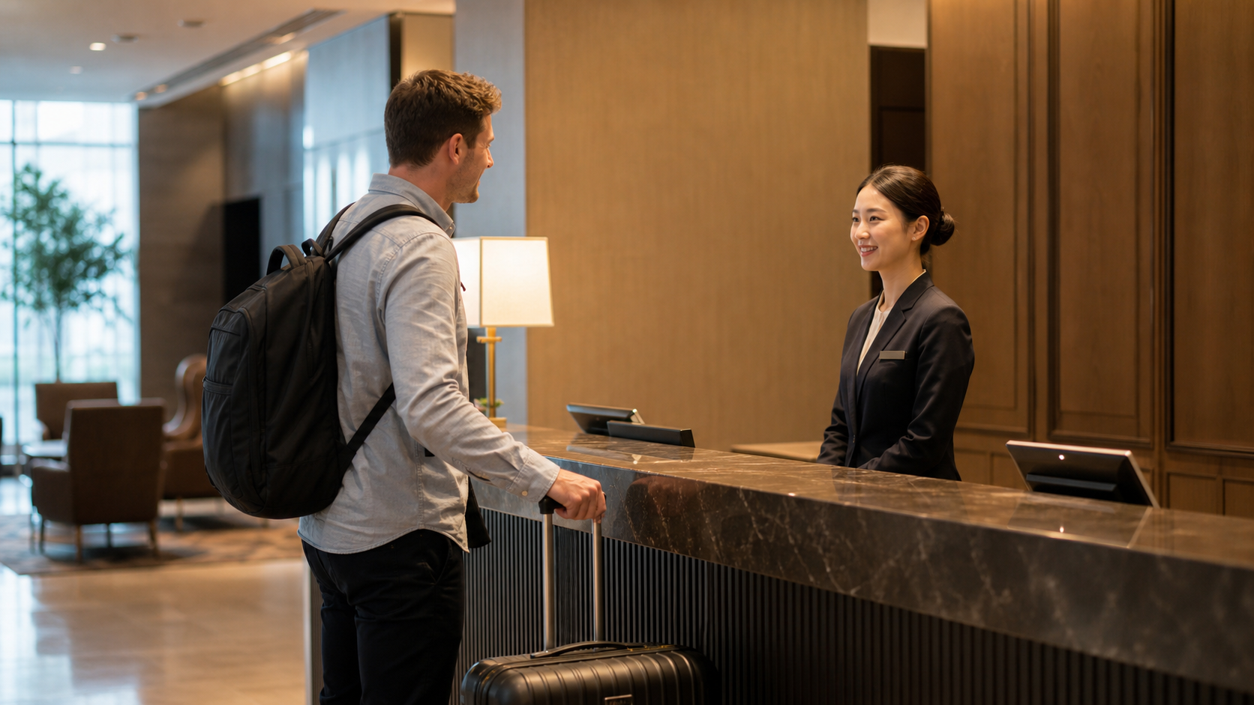
Photo briefing
Korean Hotel Check-In Words
Reservations, ID, room keys, breakfast, and checkout
체크인
예약
신분증
객실
조식
퇴실
Notes:
This opening slide sets the real hotel arrival situation. The learner sees a traveler, luggage, and a Korean front desk staff member. The lesson should feel like a practical briefing, not a grammar lecture. The learner only needs a clear sequence: start check-in, connect the reservation, show ID, then confirm room, breakfast, and checkout details. The article explains the photo sequence in the same order.

Slide 2
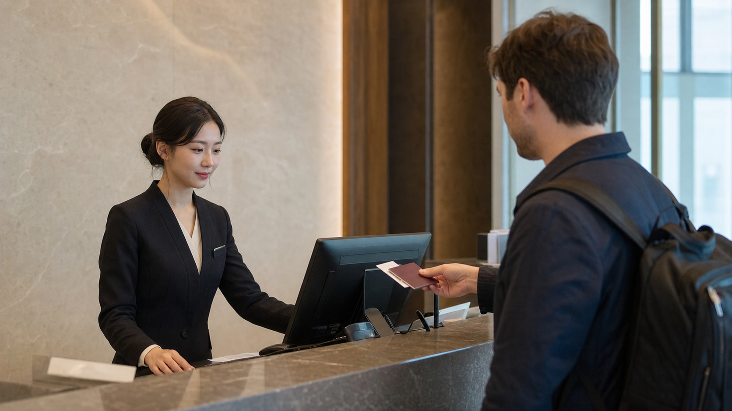
Key Check-In Words
체크인 chekeuin check-in
예약 yeyak reservation
신분증 sinbunjeung ID
객실 gaeksil guest room
조식 josik breakfast
퇴실 toesil checkout
Notes:
This slide focuses on the ID and reservation check. The vocabulary list follows the service order at a real hotel counter. 체크인 begins the process. 예약 connects the booking to the guest name. 신분증 is the ID request. 객실 points to room information. 조식 and 퇴실 are the practical details a traveler should confirm before leaving the desk.

Slide 3
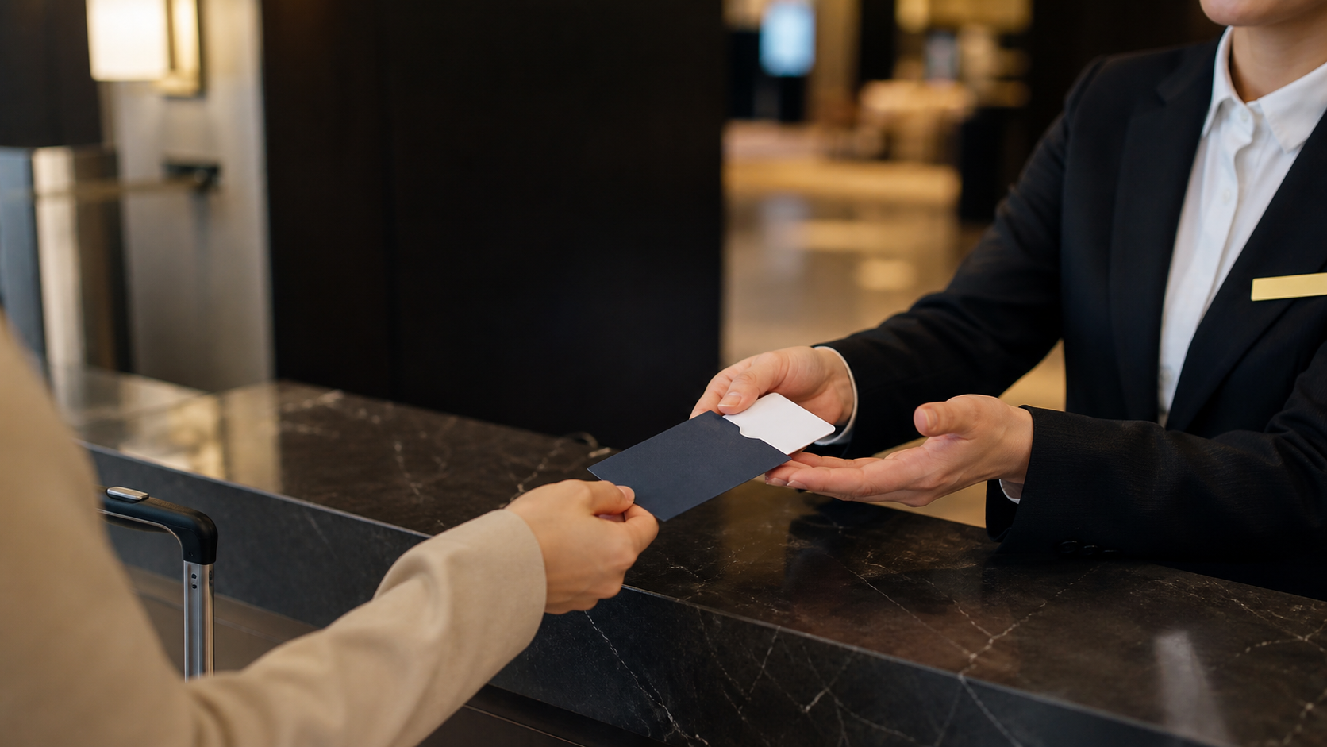
Useful Desk Formulas
예약했어요.
체크인하려고요.
Put the important word first. Keep the sentence short.
조식 포함돼요?
퇴실 몇 시예요?
Notes:
This slide uses the key card handoff to show when short formulas matter. Learners should not build long explanations while staff are waiting. 예약했어요 confirms the booking. 체크인하려고요 opens the interaction. 조식 포함돼요 asks whether breakfast is included. 퇴실 몇 시예요 confirms the checkout time. The article explains each formula as a practical signal.

Slide 4
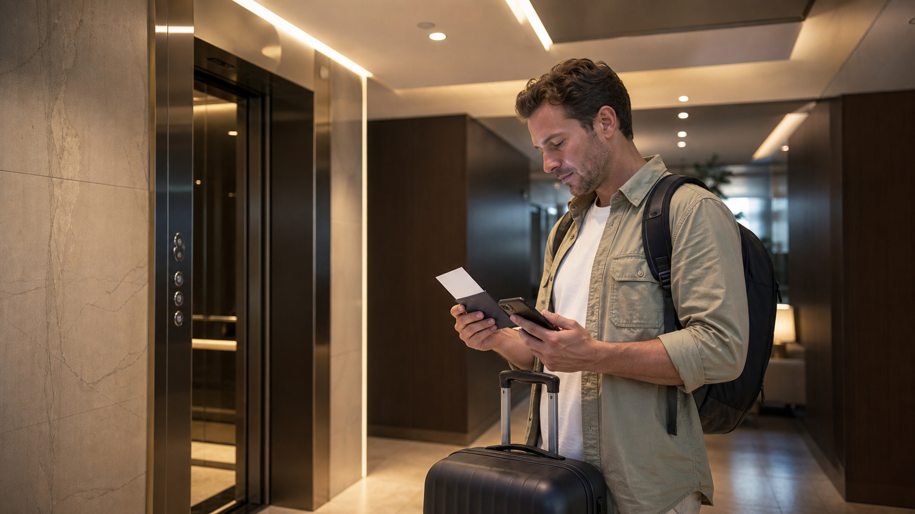
Read Check-In in 3 Steps
1. Start with 예약 or 체크인.
2. Show 신분증 when asked.
3. Confirm 객실, 조식, 퇴실.
Notes:
This slide shows the traveler checking details after receiving the key card. It mirrors the Bs3001 briefing style: identify the function word, connect it to the next signal, and act. At a hotel, the learner starts with reservation or check-in, responds to the ID request, then confirms room, breakfast, and checkout. The sequence matters more than translating every sentence.

Slide 5
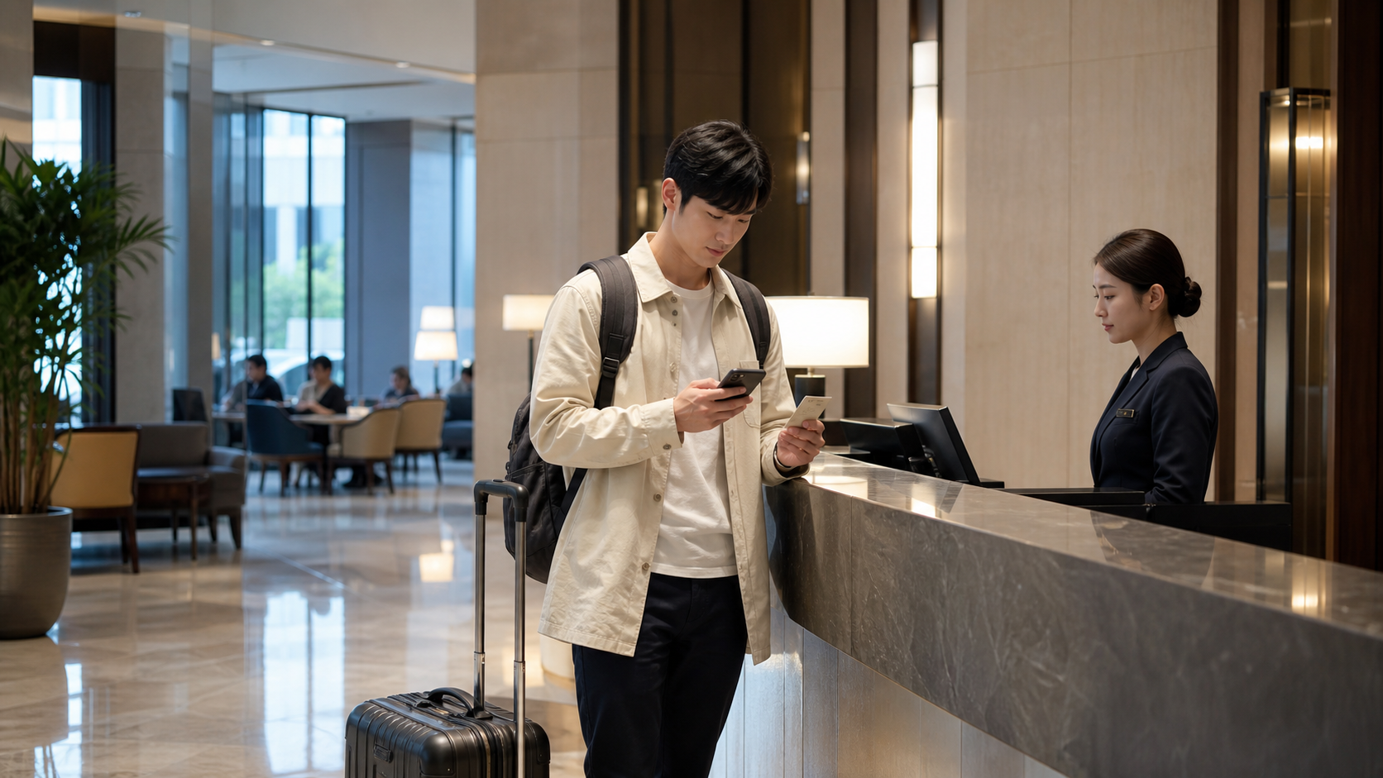
Mistakes and Practice
• Do not confuse 체크인 and 퇴실.
• Do not miss 신분증.
• Check 조식 before leaving.
• Ask one short question.
Notes:
The final slide prepares the mistake and practice sections. Beginners often confuse the arrival and departure words. They may also continue explaining the reservation when staff only asked for ID. Breakfast details can be missed because they are often said quickly. The article closes with recognition questions, a mini scenario, and a compact review table.

