Slide 1
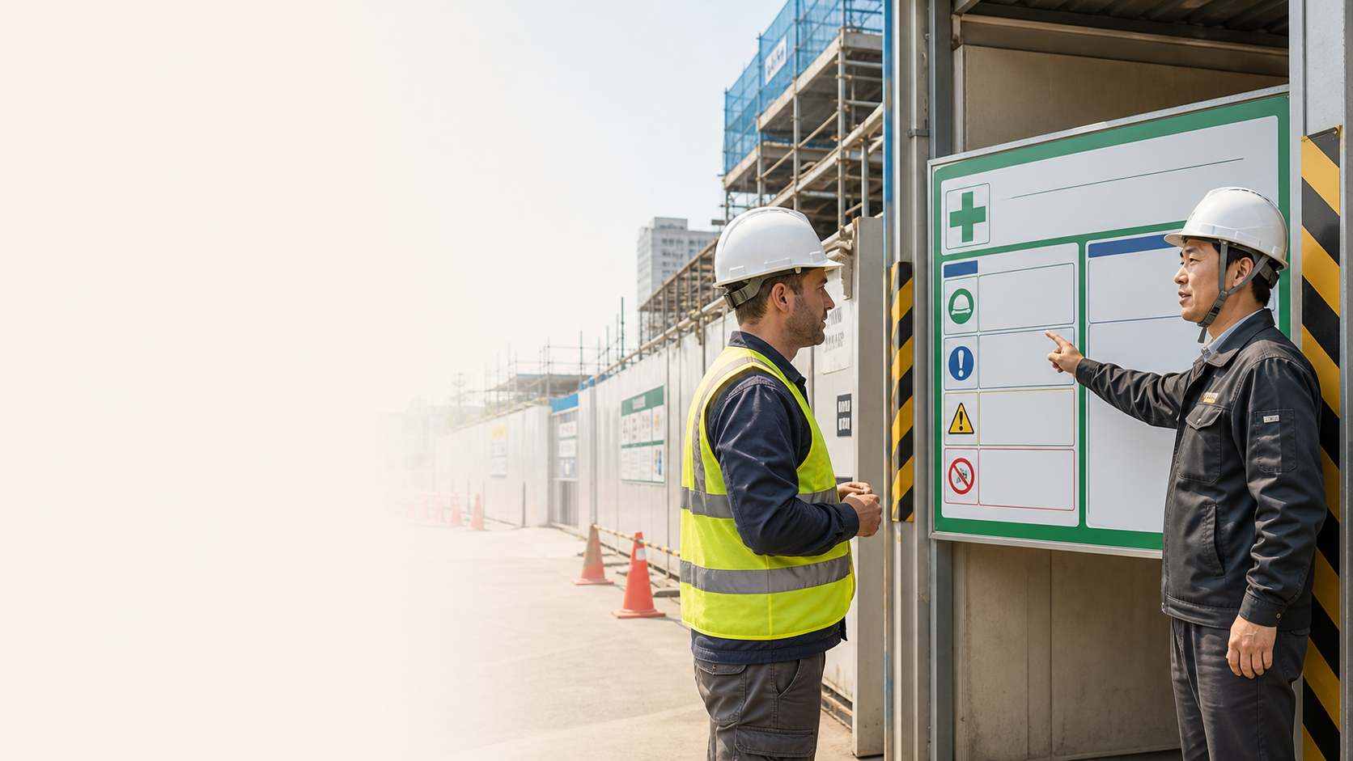
BSkorean
Safety
Read Safety Korean First
안전모
주의
출입금지
- Find the safety word before moving
- Connect the word to a real action
- Ask if an instruction is unclear
Korean Construction Safety Words for Foreign Workers

Slide 2
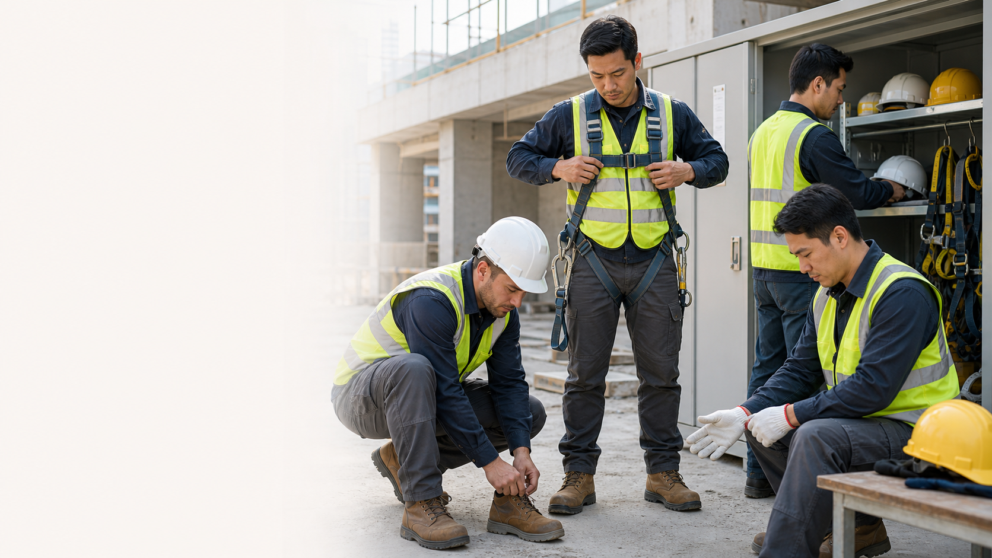
BSkorean
PPE
Protective Gear Words
안전모
안전화
안전벨트
- 안전모 = safety helmet
- 안전화 = safety shoes
- 착용하세요 = wear / put on
Korean Construction Safety Words for Foreign Workers

Slide 3

BSkorean
Signs
Hazard and No-Entry Signs
위험
주의
출입금지
- 위험 = danger
- 주의 = caution
- 출입금지 = no entry
Korean Construction Safety Words for Foreign Workers

Slide 4
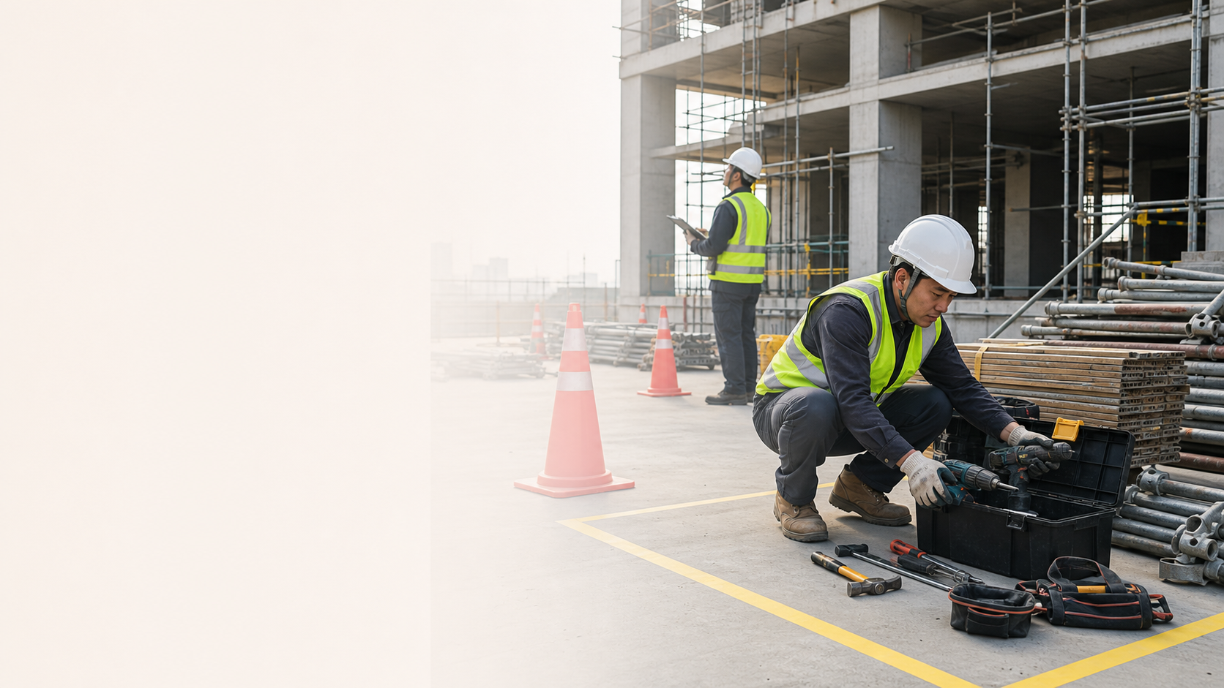
BSkorean
Site
Tools and Material Area
공구
자재
정리
- 공구 = tools
- 자재 = materials
- 정리하세요 = organize / put away
Korean Construction Safety Words for Foreign Workers

Slide 5
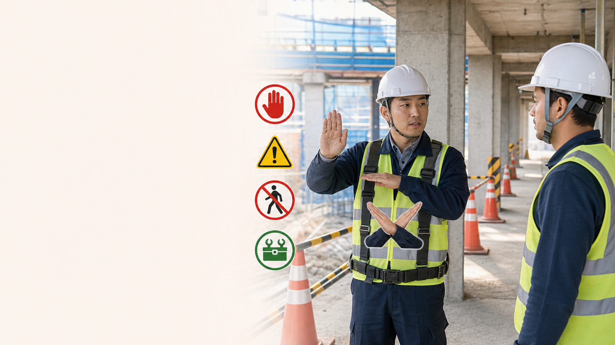
BSkorean
Listen
Supervisor Instructions
멈추세요
조심하세요
마세요
- 멈추세요 = stop
- 조심하세요 = be careful
- -지 마세요 = do not do it
Korean Construction Safety Words for Foreign Workers

Slide 6

BSkorean
Review
Practice Before You Work
읽기
듣기
확인
- Read signs as instructions
- Listen for action verbs
- Practice this set in Word Practice
Korean Construction Safety Words for Foreign Workers

