Slide 1
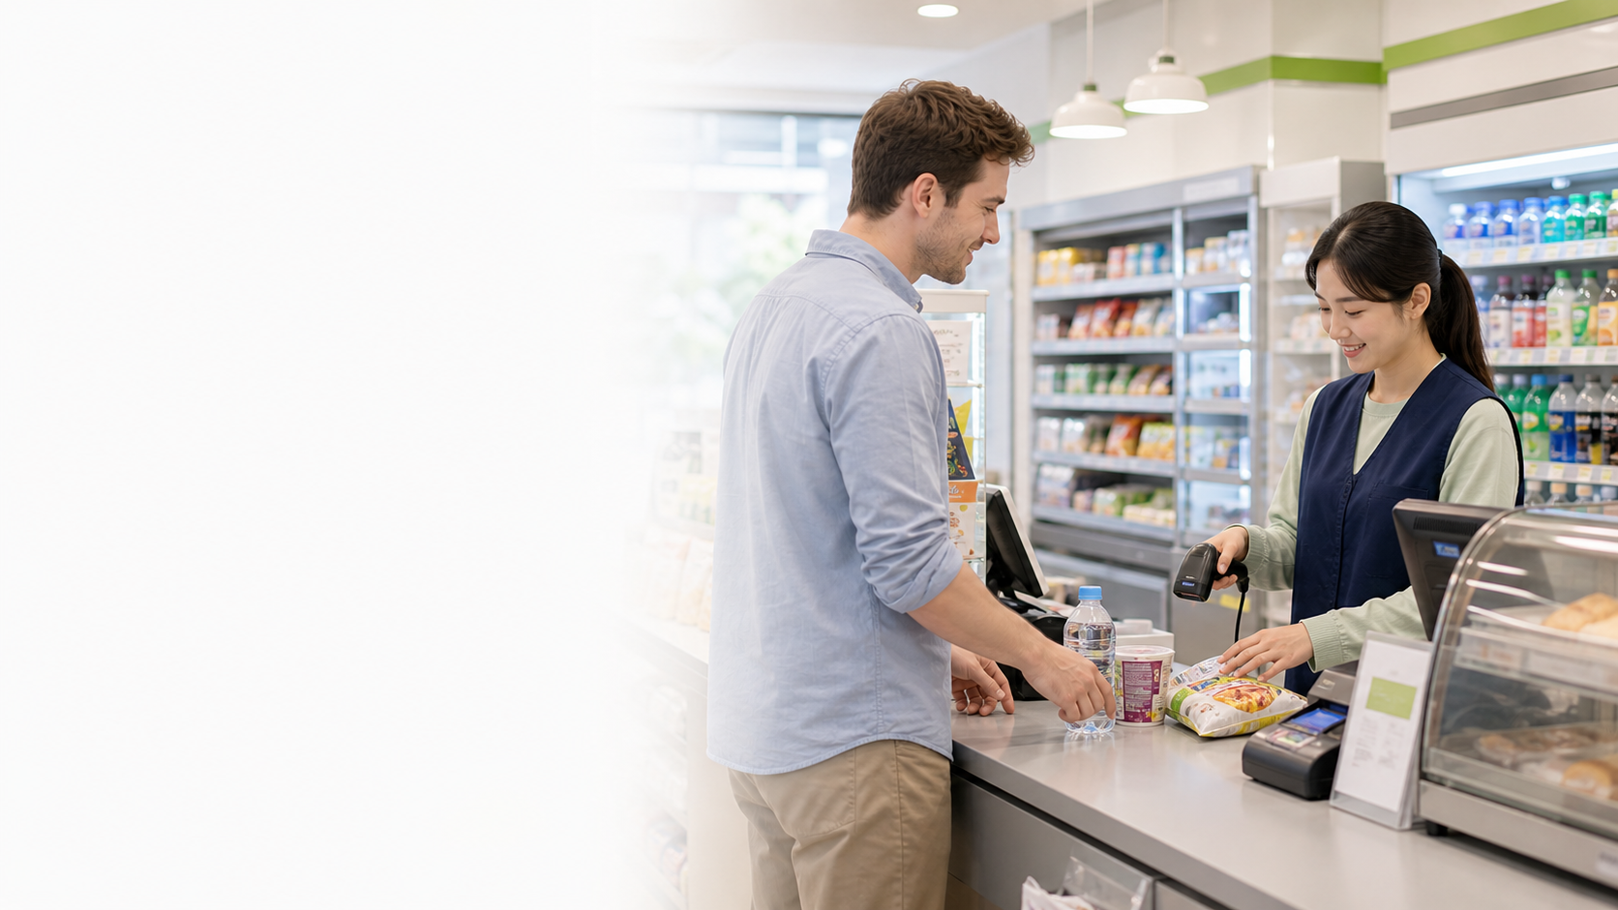
BSkorean
Checkout
Korean Convenience Store Words
편의점
봉투
영수증
- Handle checkout in a real Korean convenience store
- Listen for short action questions
- Answer quickly and politely
Korean Convenience Store Words for Checkout

Slide 2

BSkorean
Situation
Fast Checkout Questions
봉투
영수증
포인트
- Staff may ask several quick questions
- Bag, receipt, points, and payment come fast
- Focus on the key word first
Korean Convenience Store Words for Checkout

Slide 3
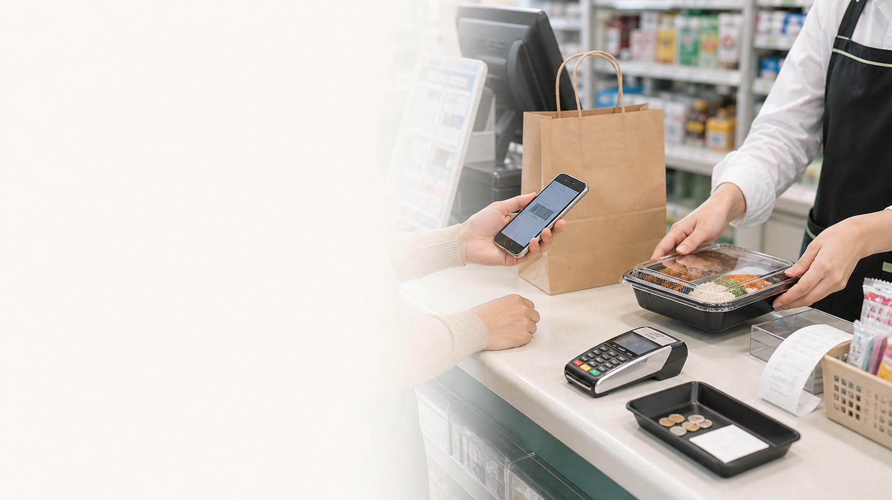
BSkorean
Words
Core Checkout Words
카드
현금
전자레인지
- 영수증 = receipt
- 봉투 = bag
- 카드 = card
- 현금 = cash
- 전자레인지 = microwave
Korean Convenience Store Words for Checkout

Slide 4
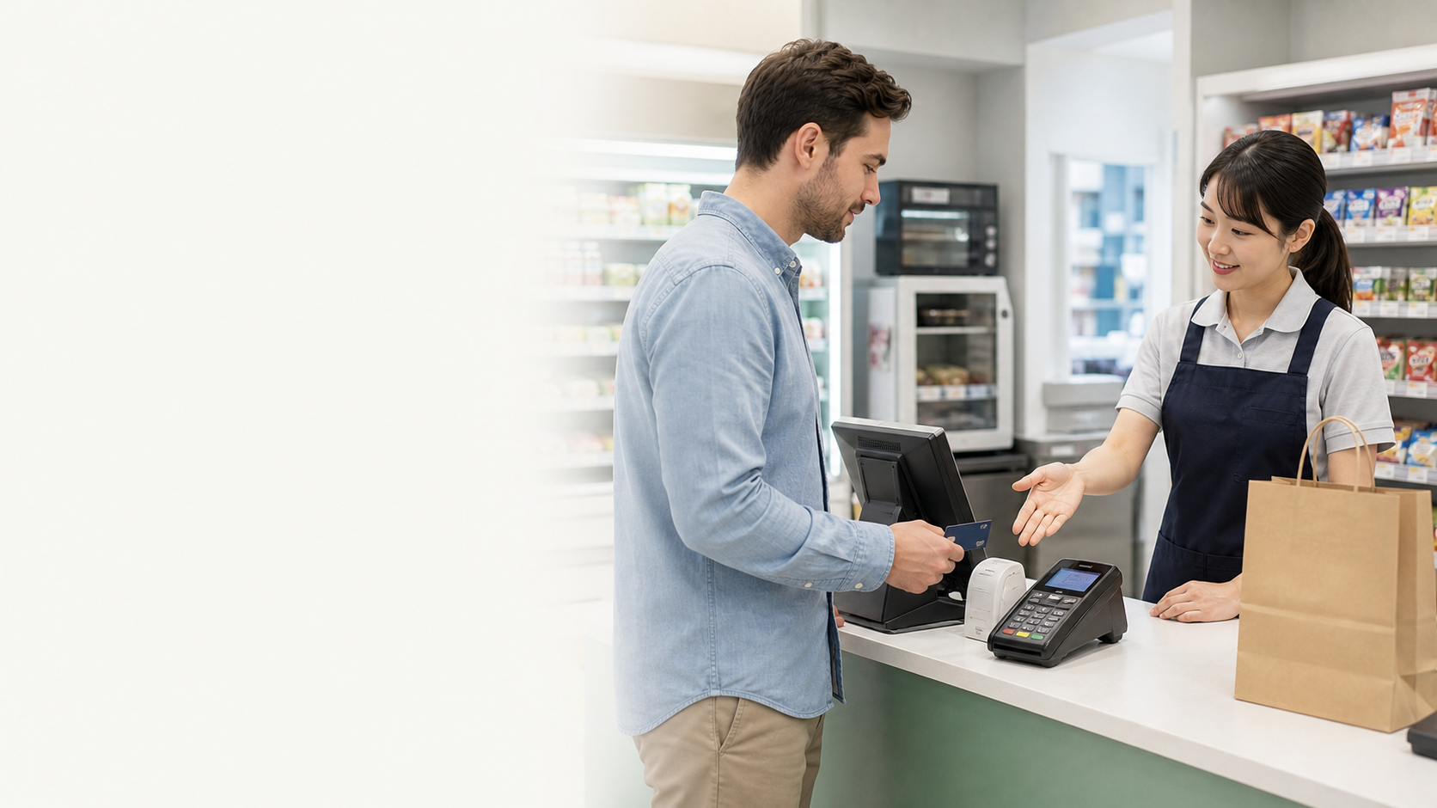
BSkorean
Patterns
Useful Checkout Patterns
필요하세요?
로 할게요
데워주세요
- 봉투 필요하세요? = Do you need a bag?
- 카드로 할게요 = I will pay by card
- 데워주세요 = Please heat it up
Korean Convenience Store Words for Checkout

Slide 5
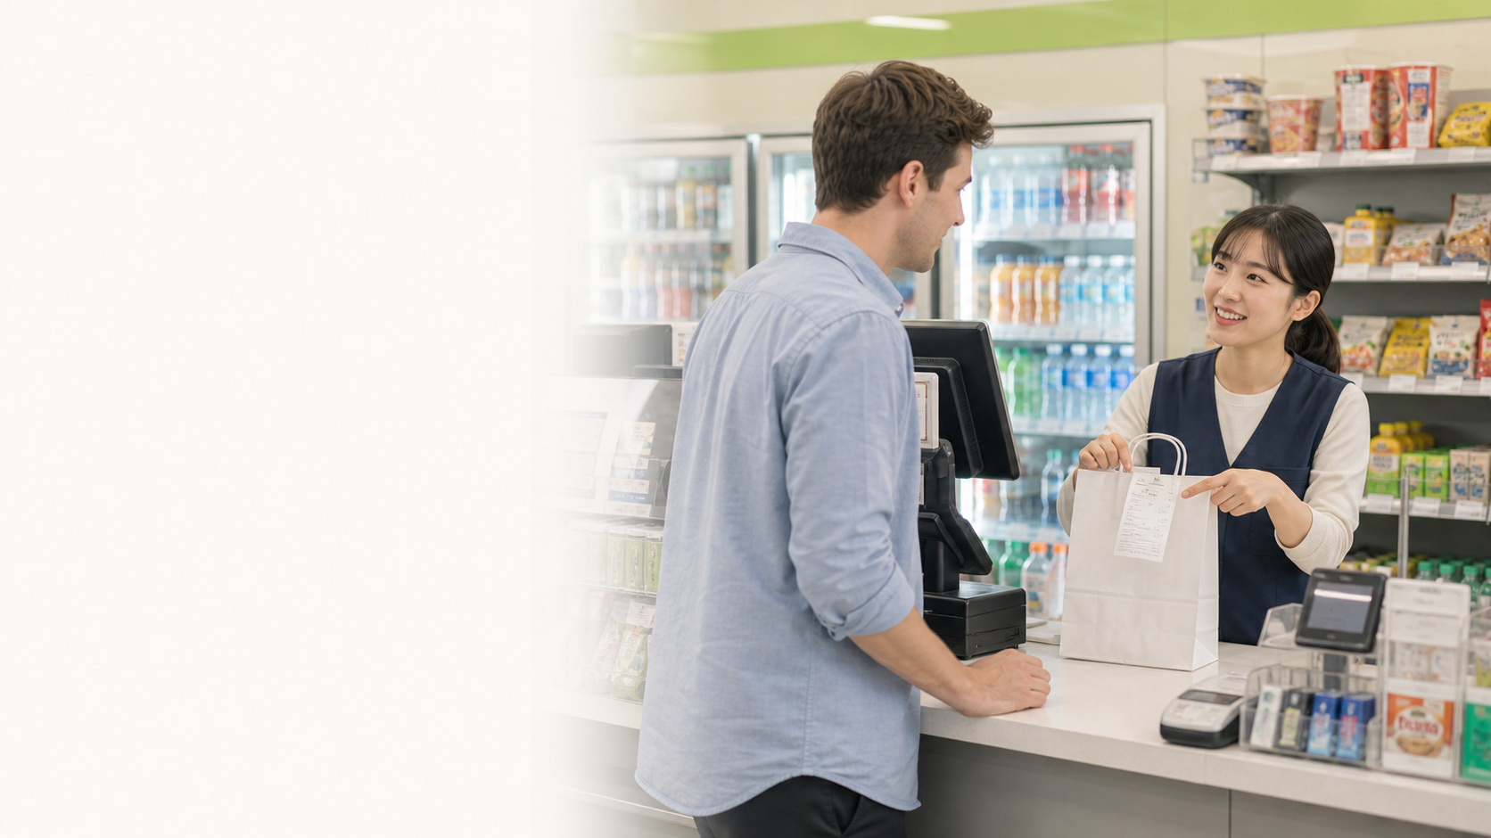
BSkorean
Dialogue
Real Checkout Dialogue
네
아니요
괜찮아요
- Cashier: 봉투 필요하세요?
- Customer: 네, 봉투 주세요.
- Cashier: 영수증 필요하세요?
- Customer: 아니요, 괜찮아요.
Korean Convenience Store Words for Checkout

Slide 6
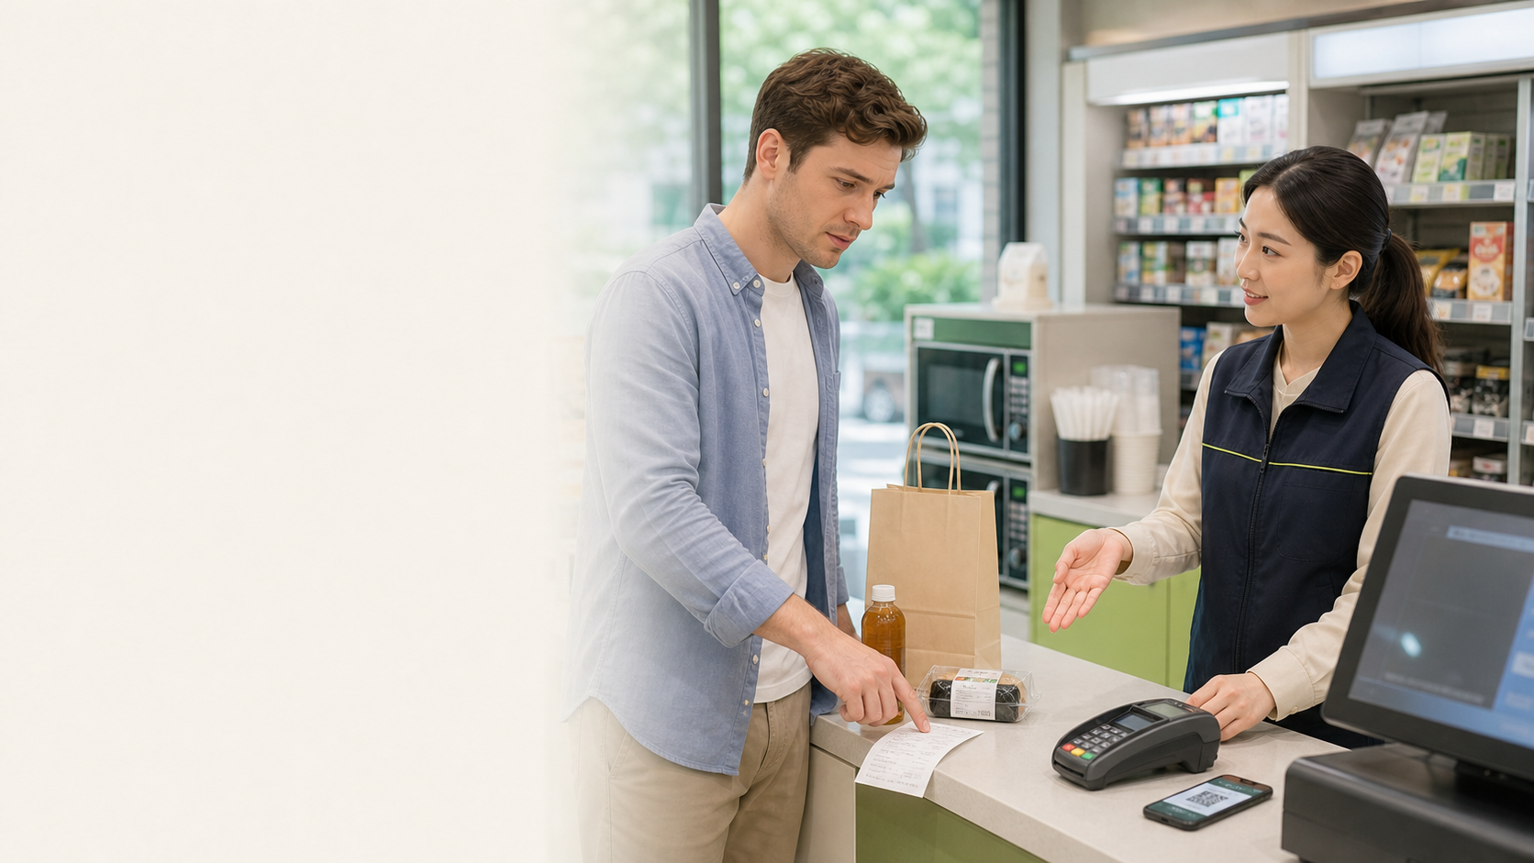
BSkorean
Mistakes
Common Checkout Mistakes
포인트
영수증
결제
- Do not answer every question with a full sentence
- 포인트 is membership points, not payment
- 영수증 is receipt, not a product
- Use short answers at the counter
Korean Convenience Store Words for Checkout

Slide 7
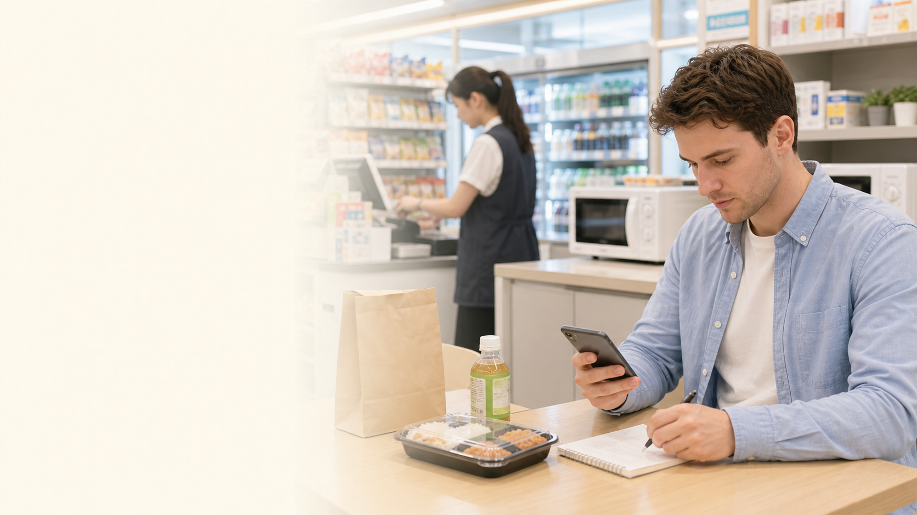
BSkorean
Review
Practice the Checkout
카드로
없어요
데워주세요
- 1. Listen for the key word
- 2. Choose yes, no, or payment method
- 3. Ask for heating if needed
- 4. Review these words in Word Practice
Korean Convenience Store Words for Checkout

