Slide 1
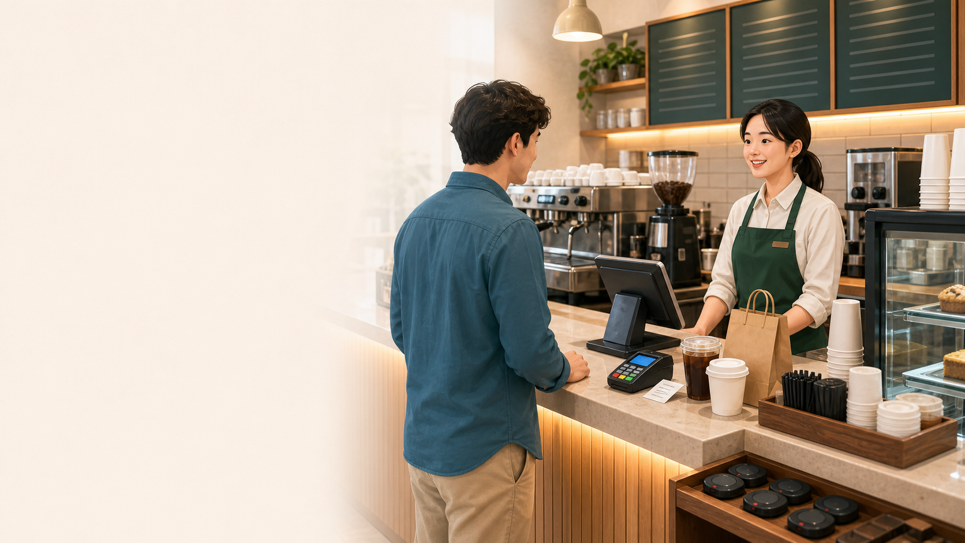
BSkorean
Title
Korean Cafe Phrases
주문
주세요
카드
- Order coffee in a real Korean cafe
- Use short, polite phrases
- Focus on the next action
Korean Cafe Phrases: A Briefing-Style Lesson

Slide 2
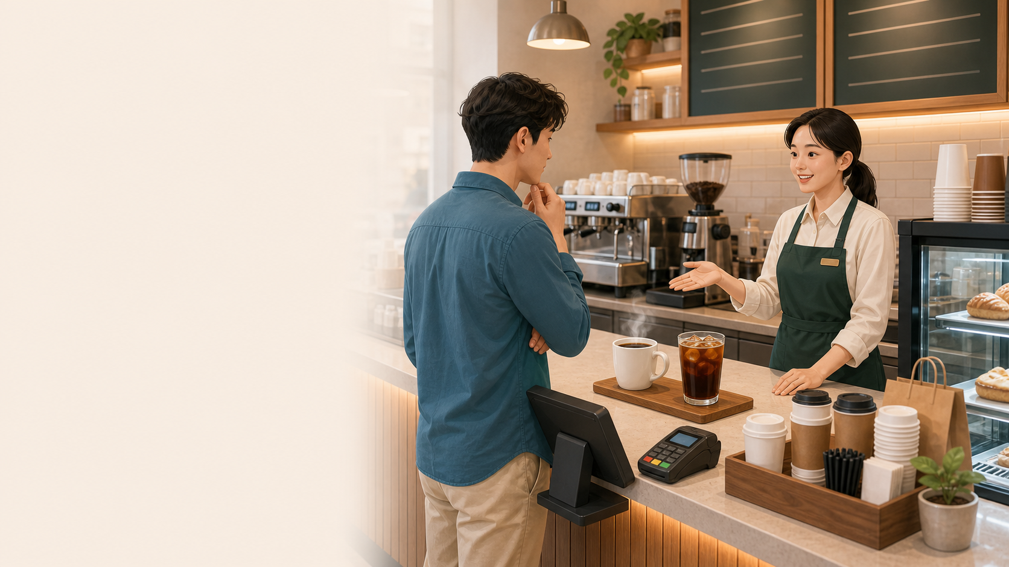
BSkorean
Choice
Hot or Iced?
아이스
따뜻한
라떼
- 아이스 = iced
- 따뜻한 = hot
- Use N로 주세요 for options
Korean Cafe Phrases: A Briefing-Style Lesson

Slide 3
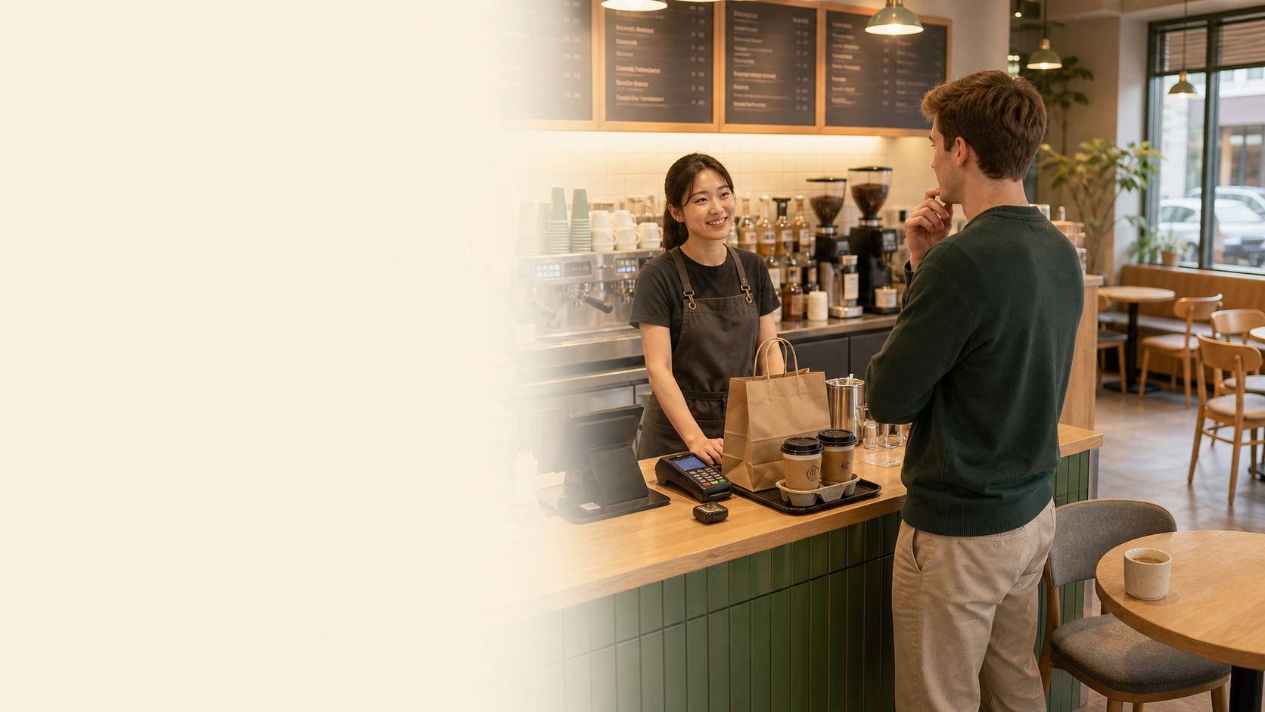
BSkorean
Place
Takeout or For Here
포장
매장
괜찮아요
- 포장 = to go
- 매장 = for here
- Answer with the option you want
Korean Cafe Phrases: A Briefing-Style Lesson

Slide 4
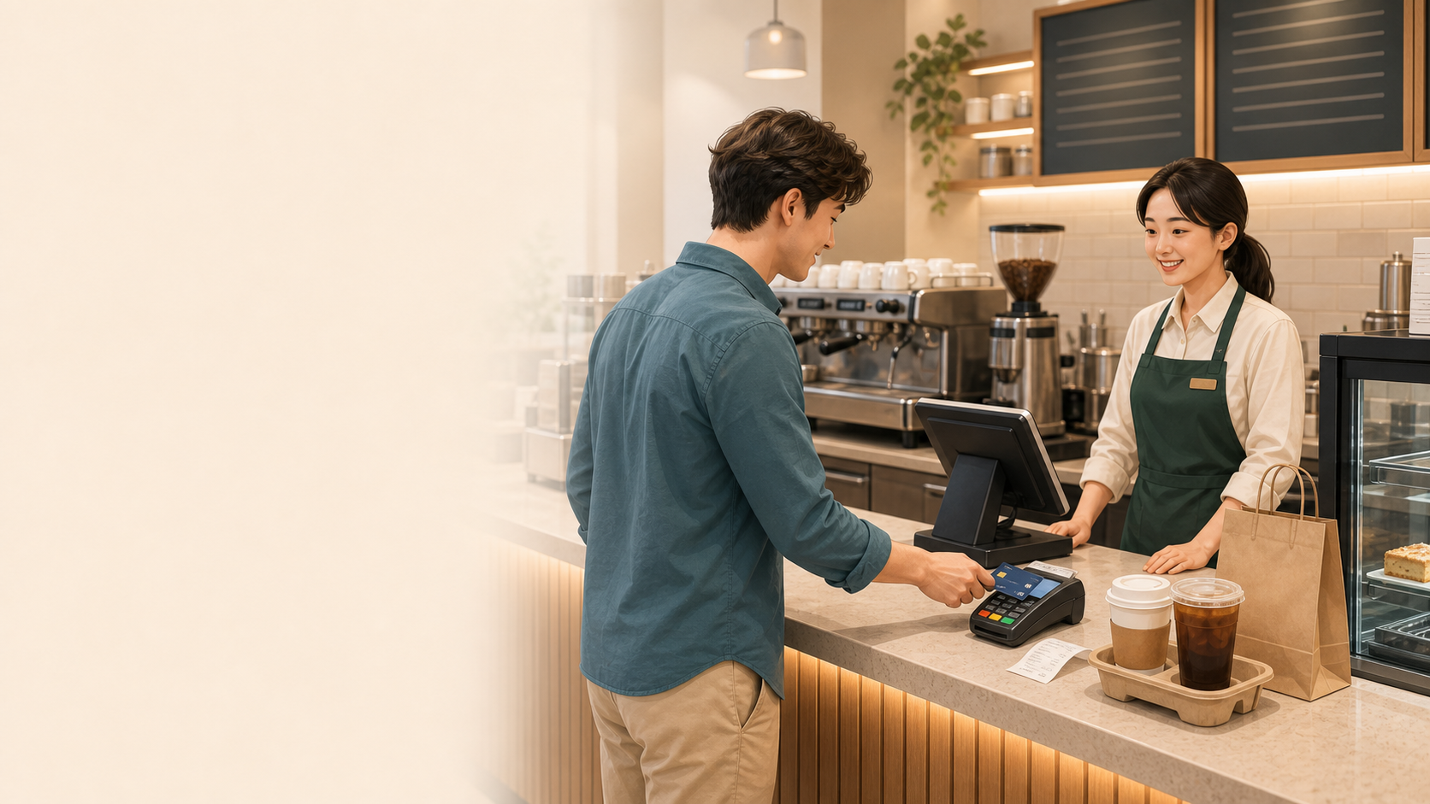
BSkorean
Payment
Card and Receipt
카드
영수증
결제
- 카드로 할게요 = I will pay by card
- 영수증 = receipt
- 아니요, 괜찮아요 = No, that is okay
Korean Cafe Phrases: A Briefing-Style Lesson

Slide 5
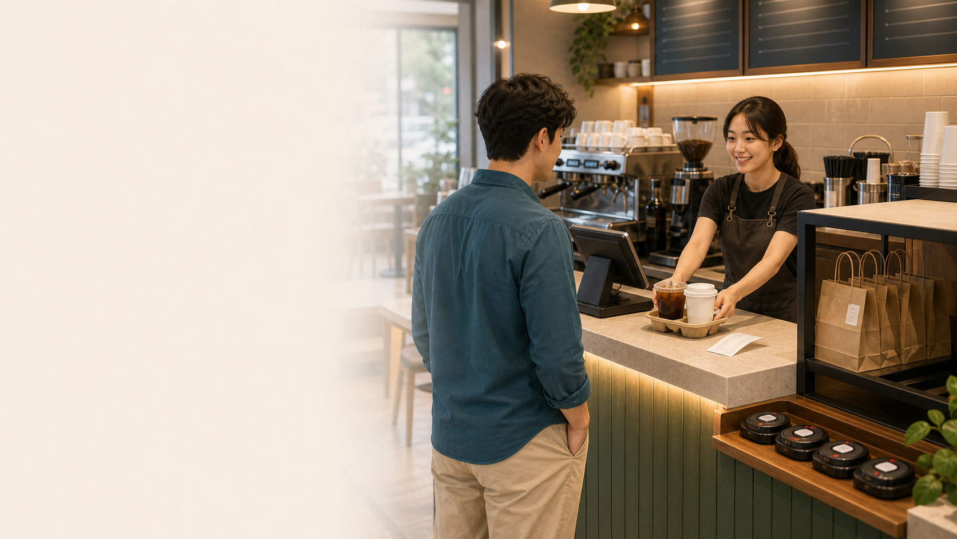
BSkorean
Pickup
Pickup and Pager
진동벨
번호
픽업
- 진동벨 = vibration pager
- Wait until your drink is ready
- Watch the pickup counter
Korean Cafe Phrases: A Briefing-Style Lesson

Slide 6
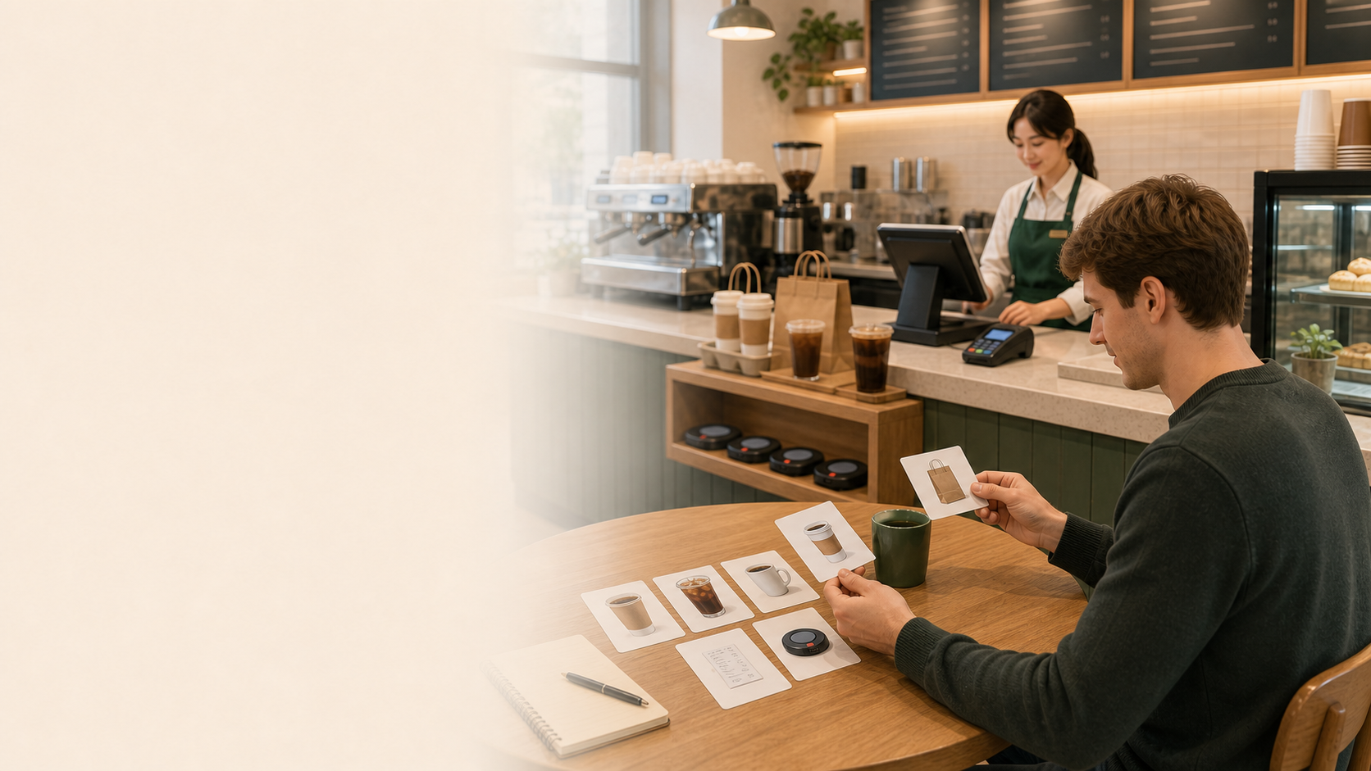
BSkorean
Review
Cafe Phrase Review
주문
포장
아이스
- Listen for the key option word
- Answer with a short phrase
- Practice again in Word Practice
Korean Cafe Phrases: A Briefing-Style Lesson

