Slide 1

Photo briefing
Korean Delivery App Words
Order food, check address, pay safely, and read arrival time
배달
주문
메뉴
장바구니
결제
배송지
Notes:
The opening slide sets the real-life situation. A learner is at an apartment door receiving a food delivery after using a Korean app. The article should explain that delivery app screens are not random. They follow a flow: choose food, check the cart, confirm the address, review price, pay, and watch arrival time. This first slide gives the learner a clear reason to read the labels carefully.

Slide 2
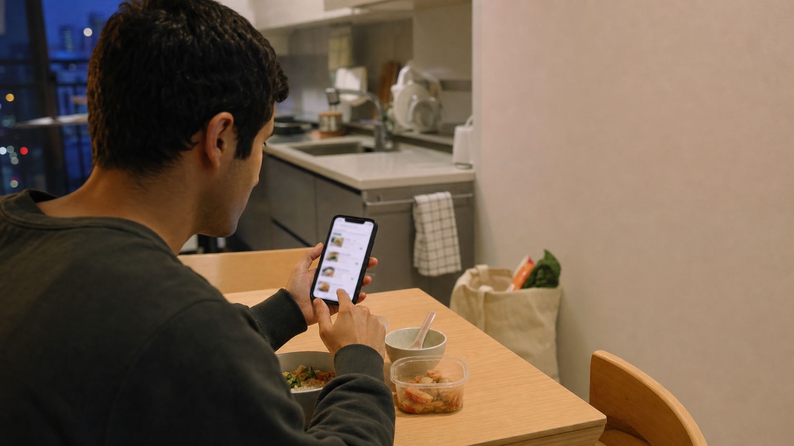
Key Delivery App Words
배달 baedal delivery
주문 jumun order
메뉴 menyu menu
장바구니 jangbaguni cart
쿠폰 / 할인 coupon / discount
결제 gyeolje payment
Notes:
This slide introduces the main labels learners should recognize first. 배달 is the broad delivery idea, while 주문 is the order itself. 메뉴 starts the food choice, and 장바구니 holds the selected items before payment. 쿠폰 and 할인 can reduce the price, and 결제 is the final payment step. The article expands this into a full table with every selected word from the Wordbook database.

Slide 3
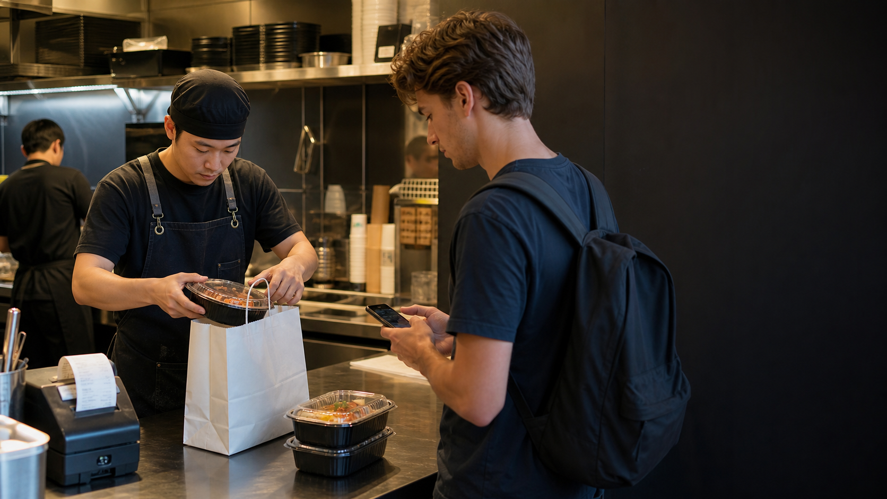
Reading Screen Formulas
메뉴 선택 = choose menu
쿠폰 적용 = apply coupon
결제수단 선택 = choose payment
배송지 확인 = check address
Read the noun first, then the action.
도착시간 확인 = check arrival time
Notes:
This slide explains formula-style reading. Delivery apps often use compact labels rather than full sentences. Learners can read the main noun first, then the action word after it. 선택 means choose, 적용 means apply, 확인 means check, and 입력 means enter. These action words help the learner understand what the screen wants. The article will connect formulas to address, payment, coupon, and arrival labels.

Slide 4
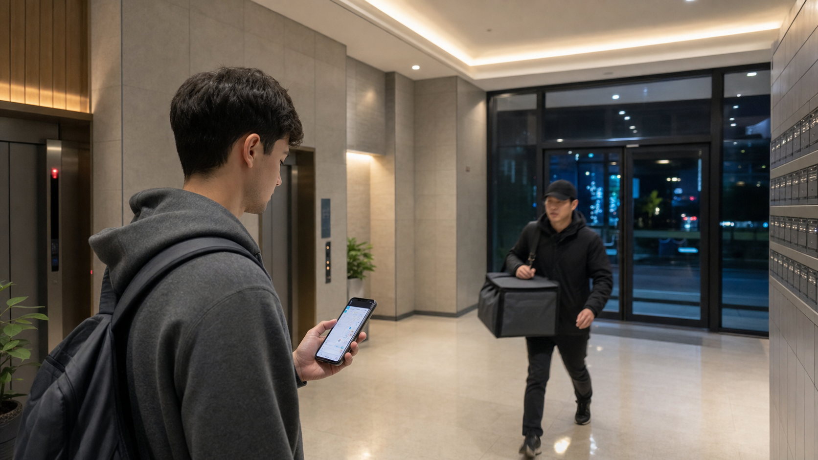
Order in 3 Steps
1. Choose 메뉴 and check 장바구니.
2. Confirm 배송지, 요청사항, 도착시간.
3. Review 쿠폰, 할인, 배송비, 결제.
Notes:
This slide turns vocabulary into a working routine. Step one is about food: choose the menu and check the cart. Step two is about delivery details: confirm the address, request field, and arrival time. Step three is about money: review coupons, discounts, delivery fee, payment method, and final payment. The article should make this feel like a practical checklist rather than a grammar lesson.

Slide 5
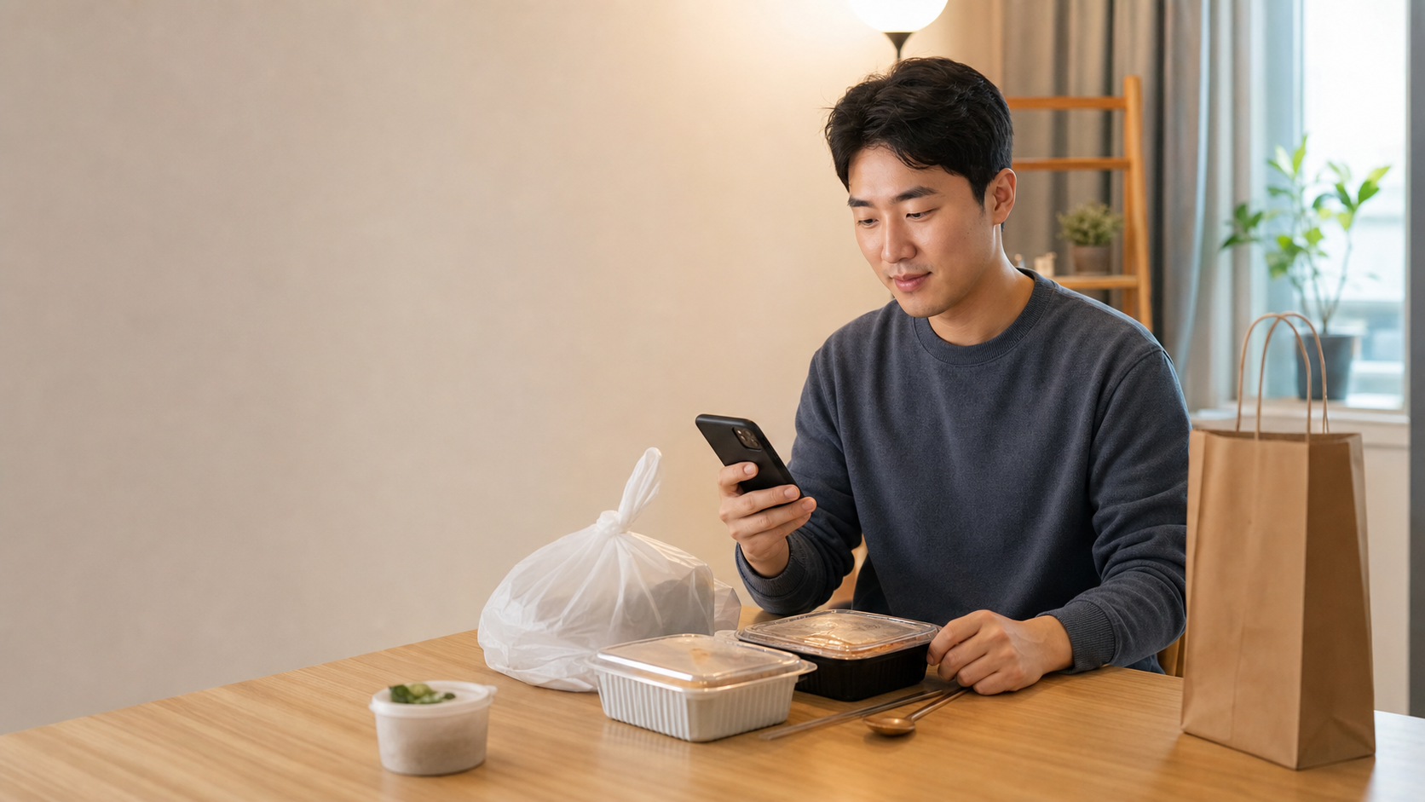
Mistakes and Practice
• Old 배송지 can send food away.
• 배송비 changes the final price.
• 취소요청 is only a request.
• 요청사항 should be short.
Notes:
The final slide prepares mistakes and practice. Beginners may trust a saved address without checking it, or miss the delivery fee before payment. They may also think 취소요청 means cancellation is already complete, but it is only a request. 요청사항 should be short and practical. The article closes with quick recognition questions, a mini scenario, a review table, and a clear takeaway for ordering food safely in Korea.

