Slide 1

Clinic briefing
Korean Hospital Reception Words
Check in, wait by number, explain symptoms, and finish the pharmacy step
접수
신분증
진료예약
대기번호
진료실
처방전
Notes:
The opening slide sets the real-life clinic situation. A learner enters a Korean clinic and needs to start at reception without understanding every sentence. The article should explain the visit as a short route: find the check-in word, show ID, confirm appointment status, wait for the number, enter the consultation room, and handle the prescription or payment step after the doctor visit.

Slide 2

Key Reception Words
접수 jeopsu check-in
접수창구 reception counter
신분증 ID card
진료예약 medical appointment
대기번호 waiting number
대기실 waiting room
Notes:
This slide introduces the words learners see near the reception desk. 접수 and 접수창구 show where to begin. 신분증 tells learners to prepare ID. 진료예약 is used when the clinic checks whether a visit was booked. 대기번호 and 대기실 guide the learner after registration. The article expands this with the full Wordbook vocabulary table.

Slide 3

Reading Formulas
접수해 주세요 = please check me in
진료예약했어요 = I booked a visit
증상이 있어요 = I have symptoms
처방전을 받았어요 = I got a prescription
Use one short sentence at the desk.
Notes:
This slide turns the core words into practical formulas. It should not become a grammar lecture. The learner only needs short, safe sentences for reception and the pharmacy step. 접수해 주세요 starts the visit. 진료예약했어요 answers an appointment question. 증상이 있어요 explains the reason for coming. 처방전을 받았어요 prepares the learner for the pharmacy counter.

Slide 4
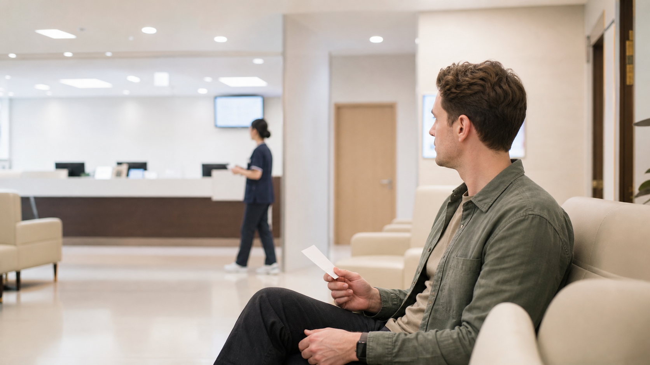
Clinic in 3 Steps
1. Start at 접수 and show 신분증.
2. Follow 대기번호 in the 대기실.
3. Enter 진료실, then check 진료비 and 처방전.
Notes:
This slide gives the practical reading method. Step one covers check-in and identity. Step two covers waiting correctly by number. Step three connects the consultation room to payment, prescription, and pharmacy. The article should make this feel similar to reading subway signs: locate the action word, match it to a place, then take the next clear step.

Slide 5

Mistakes and Practice
• Do not confuse 접수 and 진료.
• Do not miss your 대기번호.
• Keep 증상 sentences short.
• Take 처방전 to the 약국.
Notes:
The final slide prepares the mistake and practice sections. Beginners often confuse check-in with the doctor consultation, leave the waiting area, or explain too much at the desk. The article should keep the correction practical: use the correct action word, watch the number, give one short symptom sentence, and take the prescription to the pharmacy after paying the medical fee.

