Slide 1
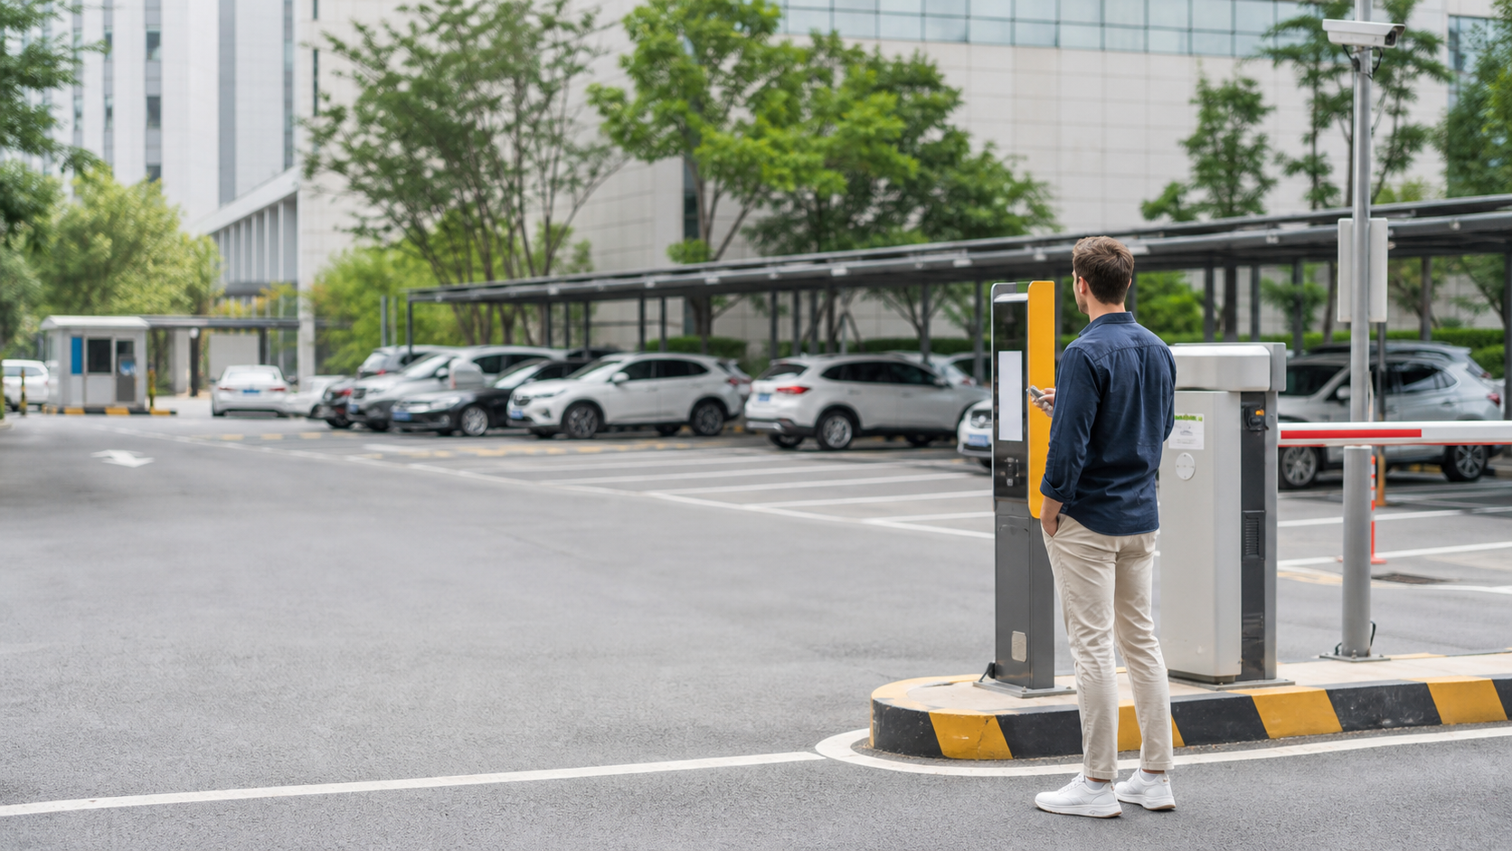
Parking briefing
Korean Parking Lot Words
Find the lot, check the fee, pay before exit, and avoid restricted spaces.
주차장
주차비
정산
결제
주차금지
주차단속
Notes:
The opening slide sets the real-life parking situation. A learner enters a Korean parking lot and needs to make quick choices without translating every notice. The article should explain the route like the subway lesson: find the place word, check whether parking is allowed, read the fee words, settle payment, and avoid warning signs. The image gives the learner a realistic public parking context before the vocabulary table appears.

Slide 2
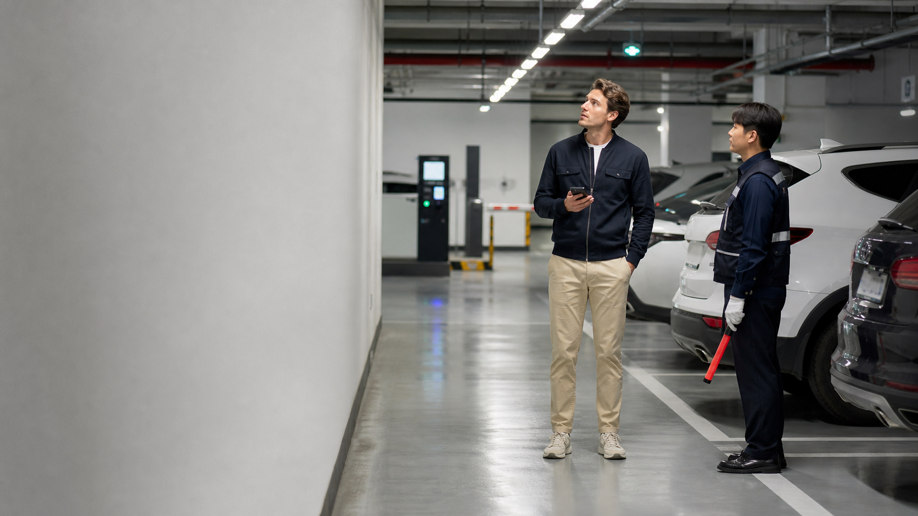
Key Parking Words
주차 / 주차장 parking / lot
주차비 / 요금 fee
정산 / 결제 settle / pay
운영시간 operating hours
주차구역 / 주차공간 area / space
주차금지 / 주차단속 no parking / enforcement
Notes:
This slide introduces the selected Wordbook vocabulary as practical groups. Place words help learners know where parking can happen. Fee and payment words tell them what to check before exiting. Operating hours help prevent an assumption that the lot is always open. Warning words stop the action. The article expands this slide with the full fourteen-row vocabulary table and keeps each usage note short.

Slide 3
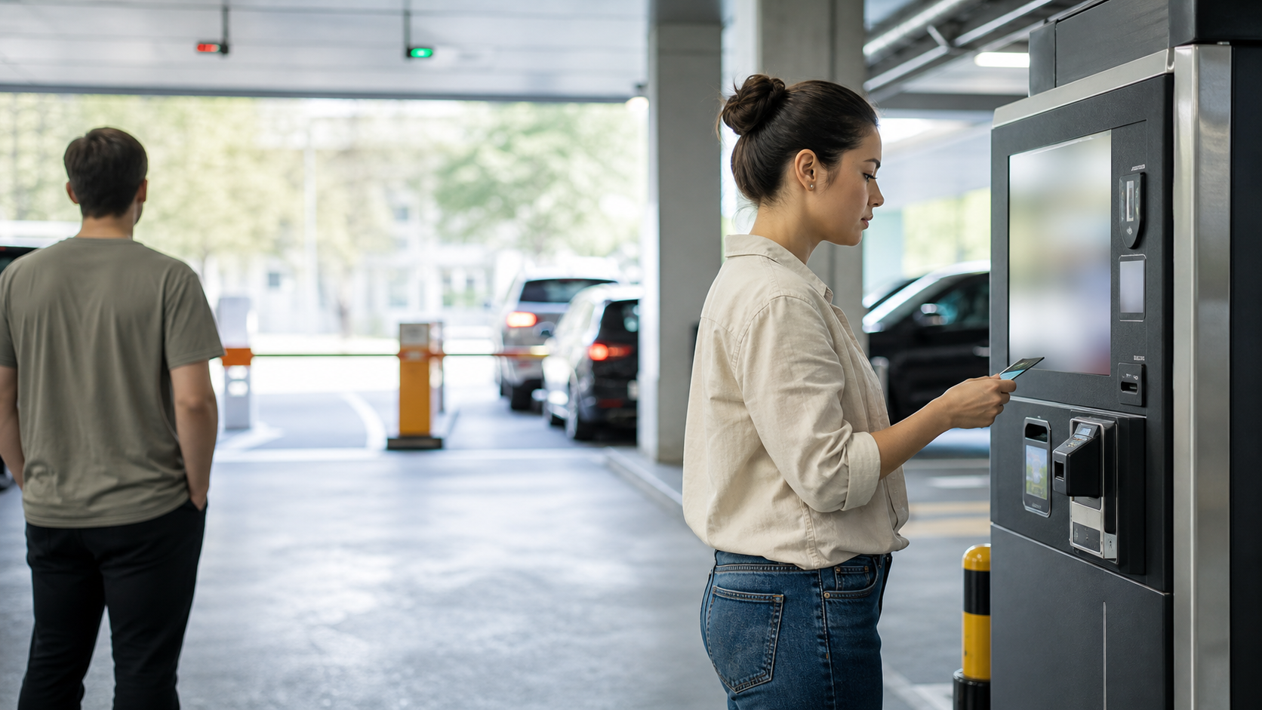
Reading Formulas
주차 + 장 = parking lot
주차 + 비 = parking fee
요금 = charge or fee
정산 = settle before exit
Read the final word first.
금지 / 단속 = stop and check
Notes:
This slide turns parking words into formula-style reading. Learners do not need a long grammar explanation. They only need to recognize how the ending word changes the action. Jang points to a place, bi and yogeum point to money, jeongsan points to settling the fee, and geumji or dansok means the learner should not park casually. The article adds short speaking formulas for asking location and fee questions.

Slide 4
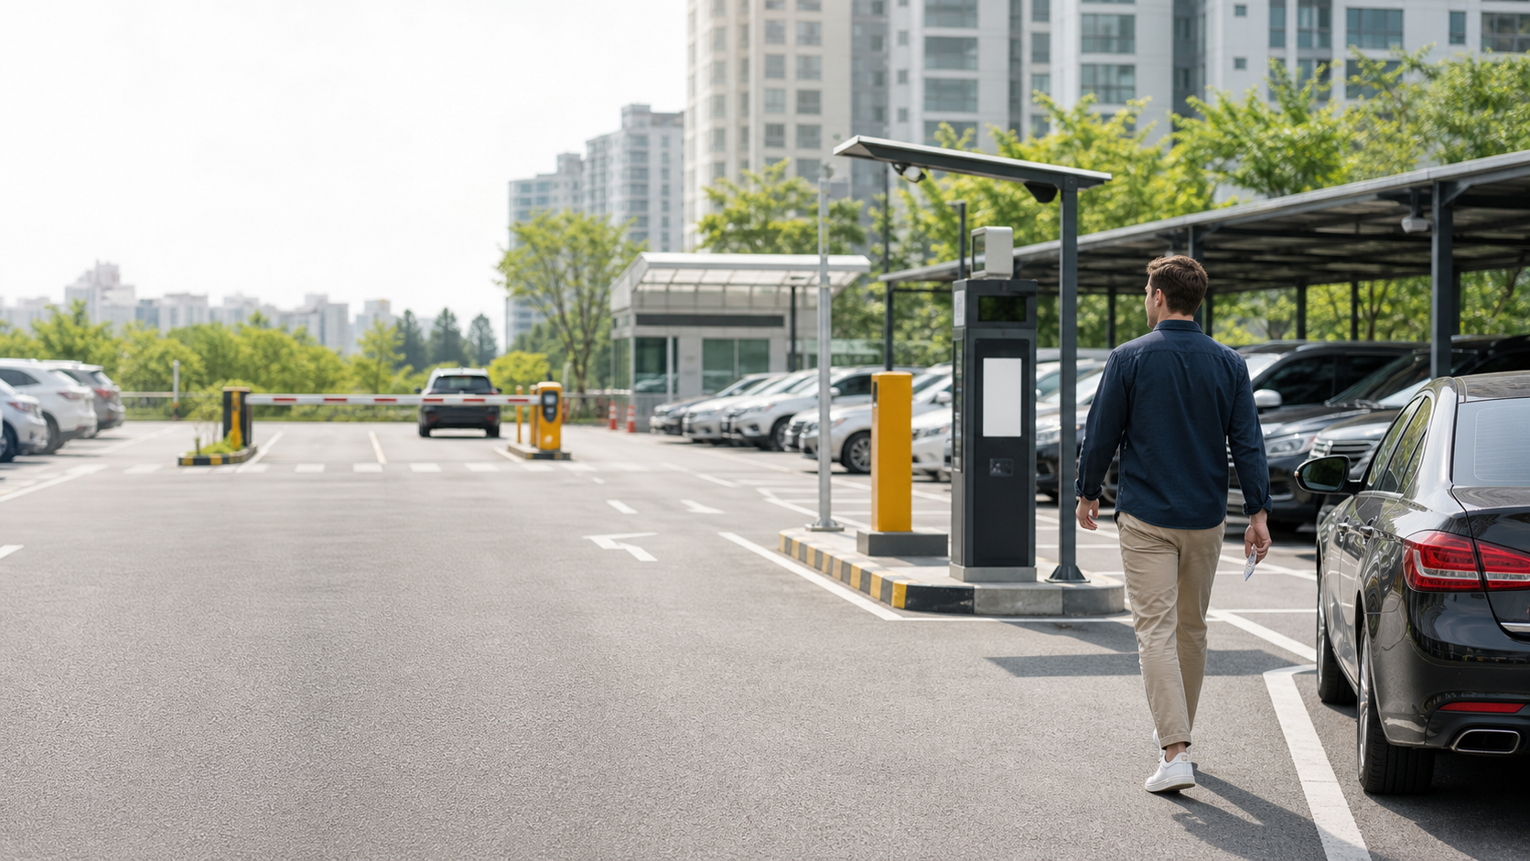
Parking in 3 Steps
1. Find 주차장 and a safe 주차공간.
2. Check 운영시간, 주차비, and 요금.
3. Use 정산 or 결제 before exit.
Notes:
This slide gives the practical reading method. Step one is finding the lot and a legal space. Step two is checking operating hours and the fee before leaving the car. Step three is paying or settling before reaching the exit barrier. The article should keep the sequence calm and concrete, so a beginner can use it while standing in front of a kiosk or driving through a garage.

Slide 5
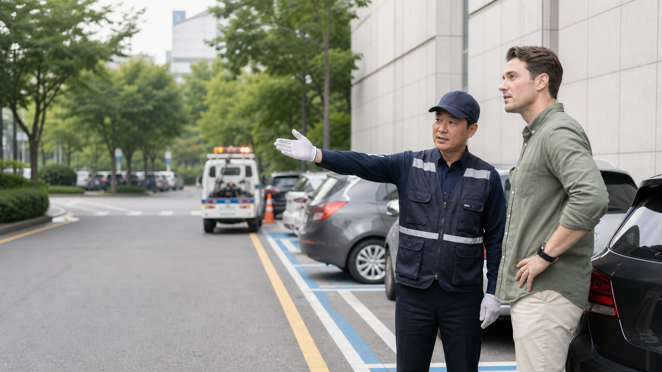
Mistakes and Practice
??Do not ignore smaller rules.
??Do not confuse 정산 and 결제.
??Move away from 주차금지.
??Treat 주차단속 as active risk.
Notes:
The final slide prepares the mistake and practice sections. Beginners often read the large parking-lot word and miss a smaller restriction. They may also treat payment words as the same, even when the machine expects a specific step. The article should correct those mistakes without adding a heavy lecture. It ends with quick recognition questions and a mini scenario using the exact vocabulary from the table.

