Slide 1

Counter briefing
Korean Public Office Words
Read the form, number, deadline, and missing document step.
신청양식
접수번호
처리기한
발급하다
누락서류
Notes:
The opening slide sets the public office situation. A learner is not reading a textbook. They are standing at a counter, holding papers, and trying to understand the next step. The article should explain the office process clearly: find the form, submit the document, keep the receipt number, check the processing deadline, and watch for missing documents. The tone should stay calm and practical.

Slide 2
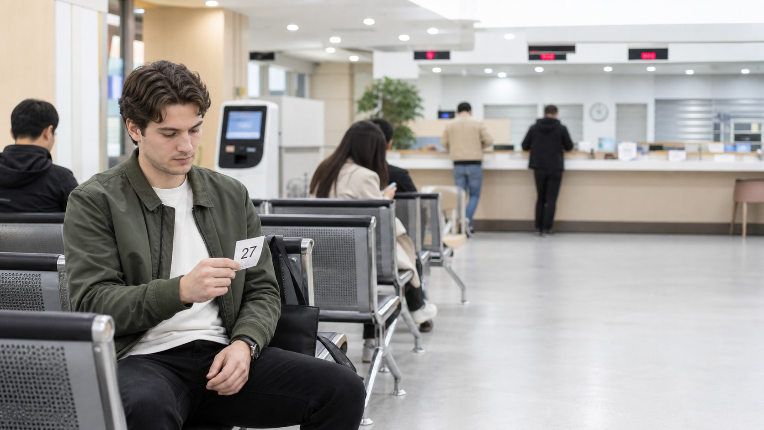
Key Office Words
신청양식 application form
접수번호 receipt number
확인서 / 증빙서 documents
민원인 / 담당자 people
보완서류 / 누락서류 document problem
Notes:
This slide introduces the selected vocabulary as a counter workflow. The learner first sees a form or notice. Then they receive or need a number. Next, the office checks documents and people labels. Finally, the learner must notice document problems. The article expands the slide with a fifteen-row table, but the slide itself stays light and readable.

Slide 3

Reading Formulas
신청양식 + 작성 = fill out form
서류 + 접수 = submit/register papers
확인서 + 발급 = issue document
누락서류 = missing paper
보완서류 = extra paper needed
Read object + action.
Notes:
The third slide teaches formula reading. Public office Korean is easier when learners read a noun and then the action beside it. A form is written, documents are registered, a confirmation paper is issued, and missing documents stop the process. The article should avoid a long grammar lecture and instead show how each formula changes the next action.

Slide 4
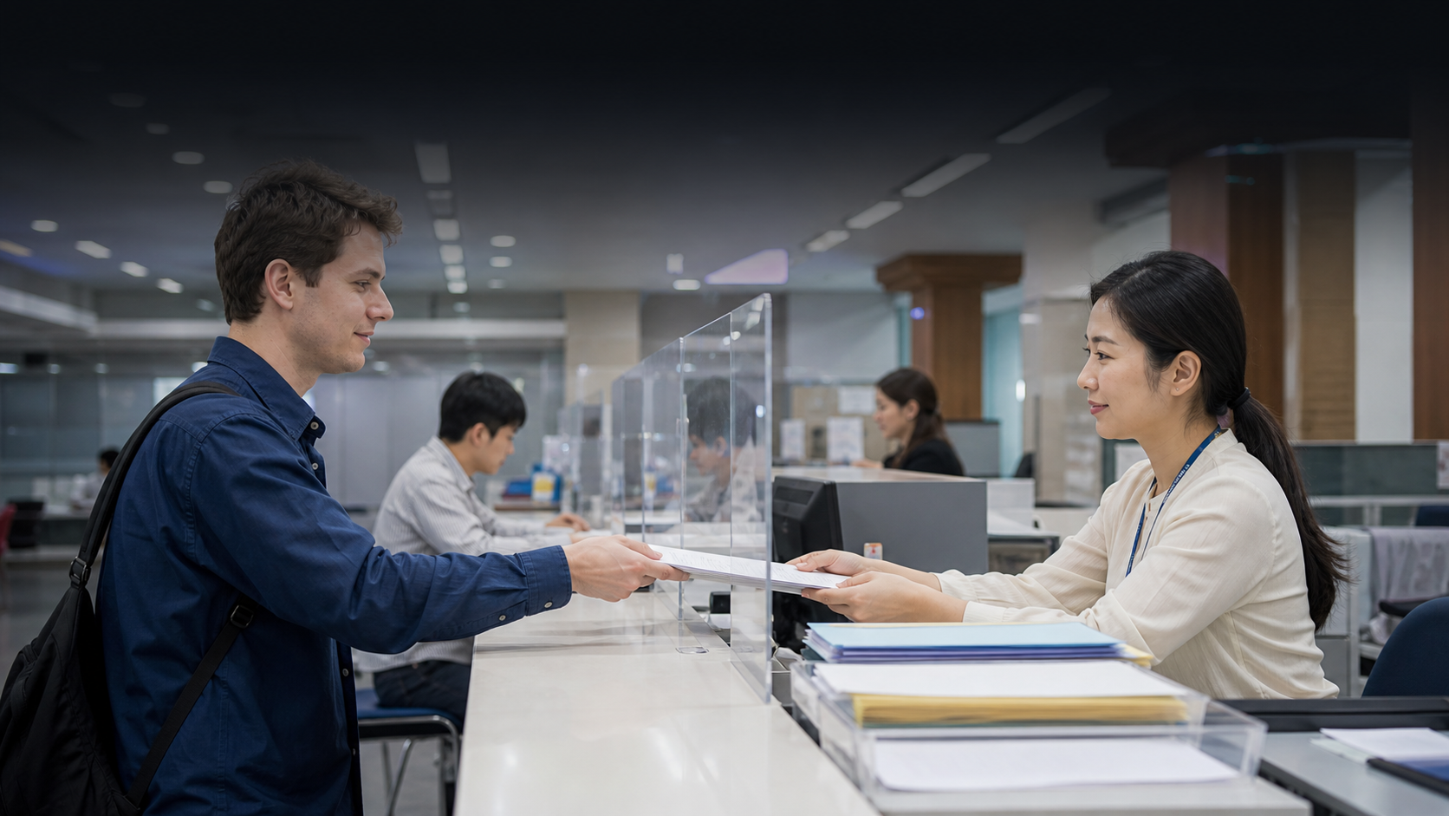
Read in 3 Steps
1. Find 신청양식 and read the notice.
2. Submit papers and keep 접수번호.
3. Check 처리기한, 발급, or missing documents.
Notes:
This slide gives the main method. First, the learner identifies the form or notice. Second, they confirm registration and keep the receipt number. Third, they track the deadline, issuance, or missing document request. The article should make this sequence feel like a real visit through a district office, not an abstract word list.

Slide 5

Mistakes and Practice
- Save every number.
- Check whether 민원인 means you.
- Ask for the 담당자 if needed.
- 누락서류 means action is required.
Notes:
The final slide prepares the mistake and practice sections. Learners may ignore numbers, confuse people labels, or wait when the office needs more documents. The article should turn those mistakes into short recognition questions. The closing message is simple: keep the number, check the deadline, and ask what document is needed.

