Slide 1
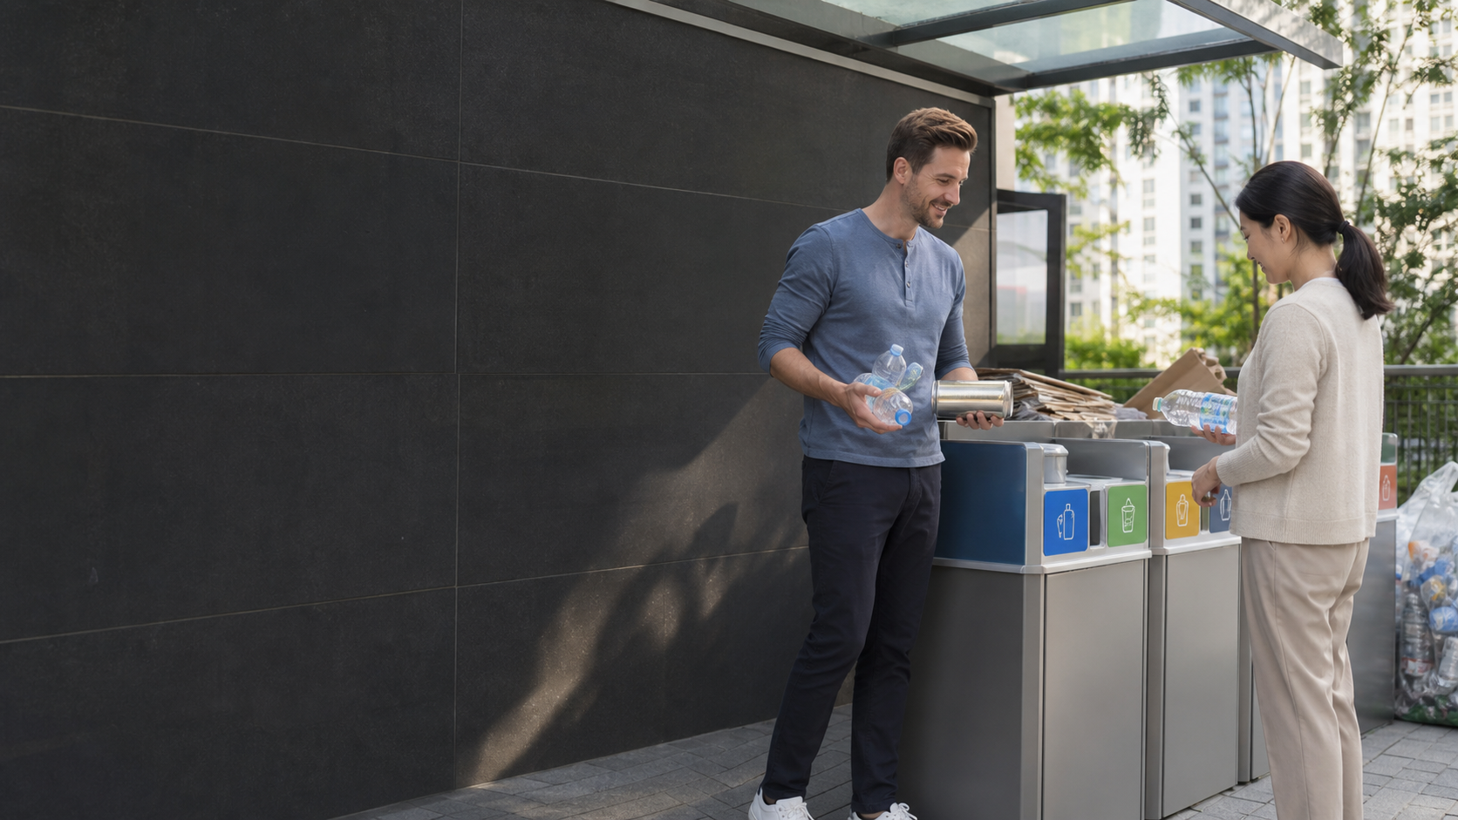
Daily Life briefing
Korean Recycling Words
Read the waste type, bag, bin, and special rule.
쓰레기
일반쓰레기
음식물쓰레기
재활용품
대형폐기물
Notes:
The opening slide sets the apartment recycling situation. The learner is holding bottles, paper, food waste, and a small trash bag. The article should explain that the first task is not translating every notice. The first task is identifying the waste type. Once the learner knows whether the item is general waste, food waste, recyclables, or bulky waste, the next action becomes much clearer.

Slide 2
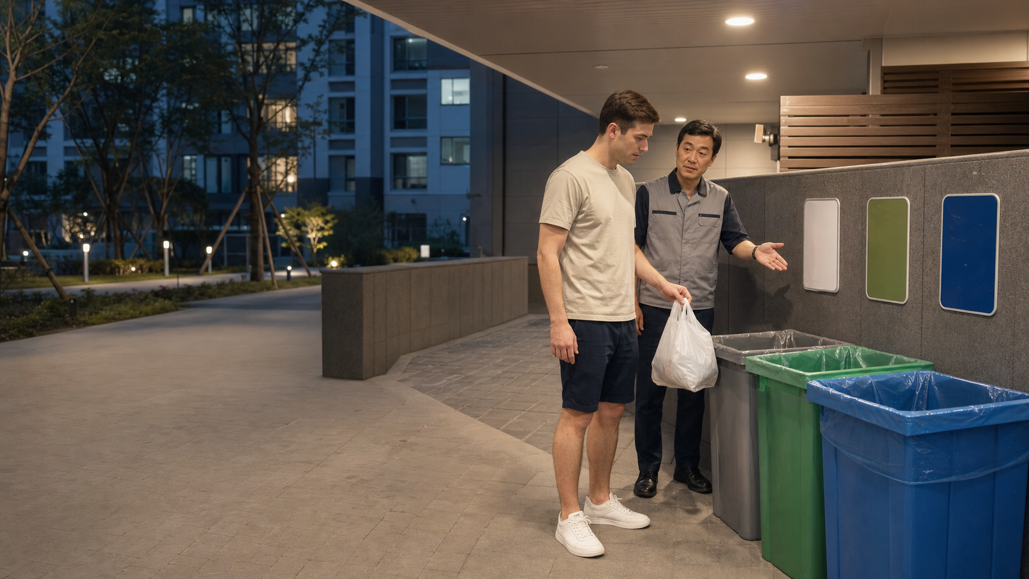
Key Waste Types
일반쓰레기 general waste
음식물쓰레기 food waste
재활용품 recyclables
쓰레기봉투 trash bag
분리수거함 sorting bin
Notes:
This slide introduces the main vocabulary groups. General waste usually points to a paid trash bag. Food waste points to a separate container or special system. Recyclables point to sorting bins. The article expands this slide with a full vocabulary table, but the slide should remain light and practical so learners can remember the decision path.

Slide 3
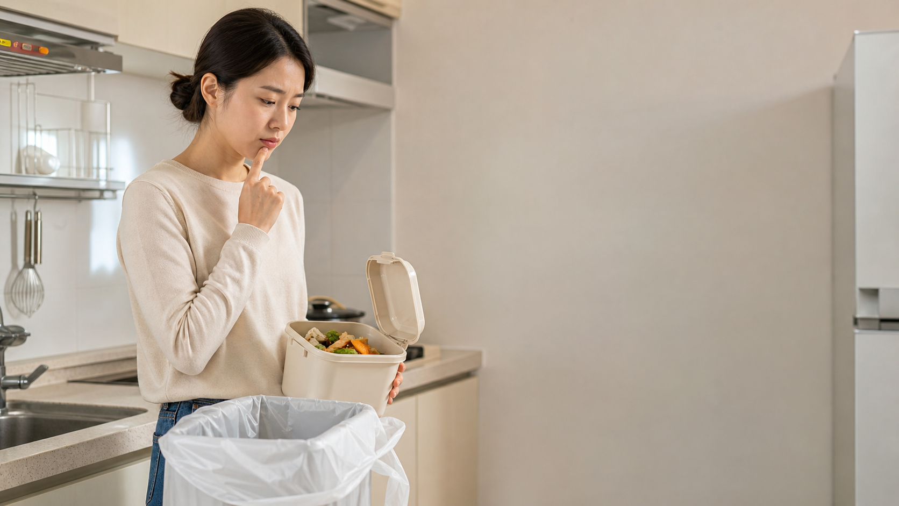
Reading Formulas
종이류 -> fold or flatten
플라스틱류 -> empty first
페트병 -> remove label
분리배출 -> sort before disposal
Notes:
The third slide teaches formula reading. A learner should scan for the material word first, then the action beside it. Paper, plastic, plastic bottles, and separate disposal each create a different action. The article should avoid a long grammar explanation and instead show how a recycling label changes what the learner does with the item in their hand.

Slide 4
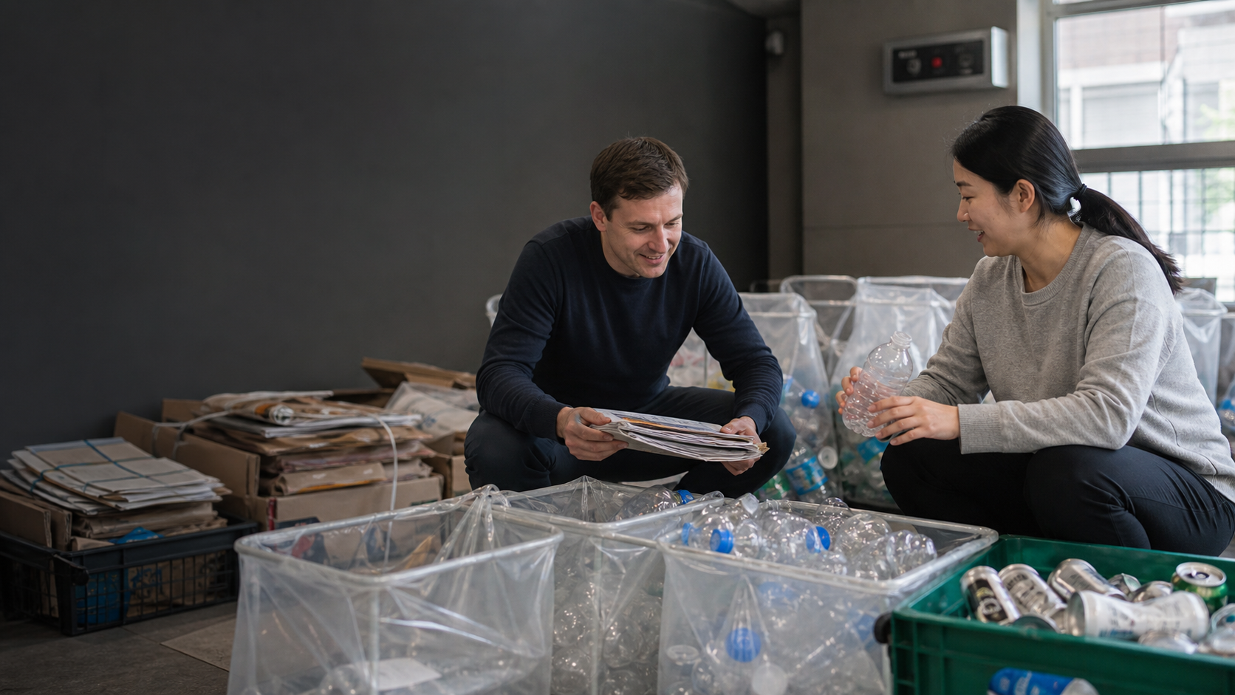
Sort in 3 Steps
1. Name the item: 종이류, 페트병, food waste.
2. Choose the place: bag, bin, or food waste container.
3. Check special rules: labels, folding, or bulky waste report.
Notes:
This slide gives the core method. First, identify the item. Second, choose the correct container or bag. Third, check whether a special rule applies. The article should make this method feel like a real moment in front of apartment bins. The learner should be able to use the method even if a notice contains many words they do not know.

Slide 5
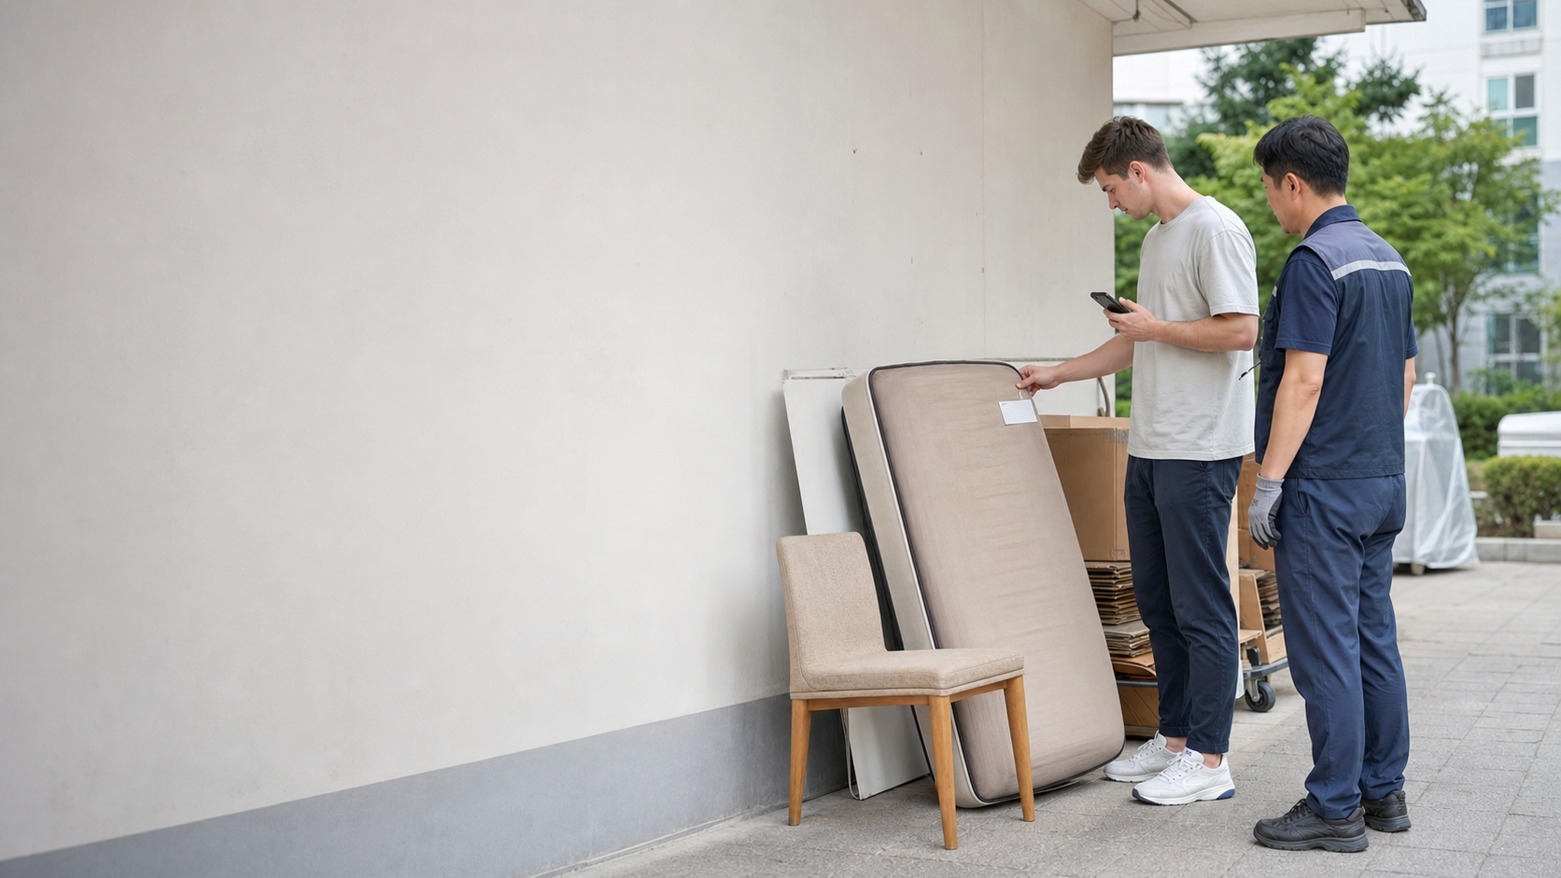
Mistakes and Practice
- Do not use 쓰레기 for every item.
- 음식물쓰레기 is separate.
- 대형폐기물 may need a report.
- 이건 어디에 버려요? = Where do I throw this away?
Notes:
The final slide prepares the mistake and practice sections. Learners often use one broad trash word, mix food waste with general waste, or leave a bulky item in the wrong place. The article turns those mistakes into recognition questions and a short speaking pattern. The closing message is simple: identify the category, sort carefully, and ask one short question before guessing.

