Slide 1
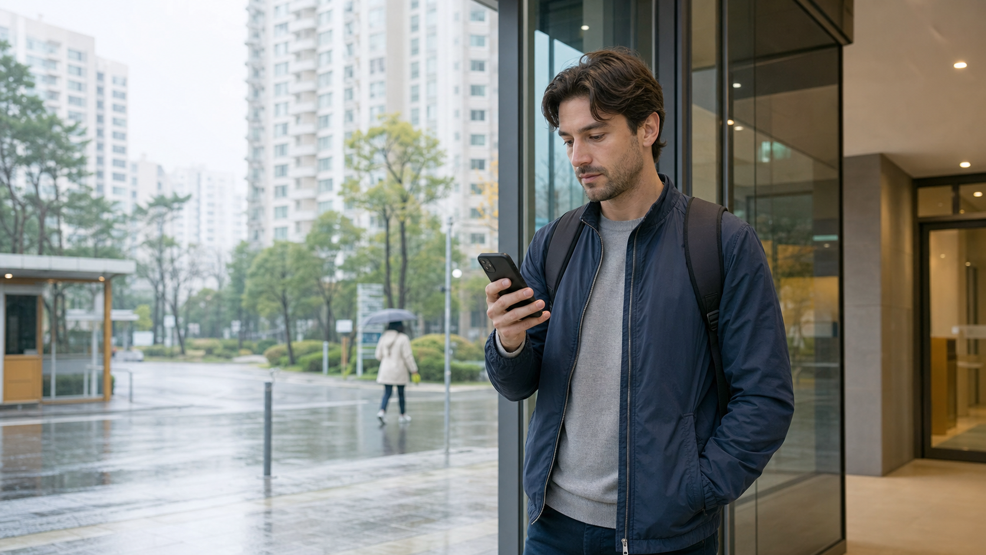
Photo briefing
Korean Weather App Words
Forecasts, temperature, rain, fine dust, and umbrella checks
날씨
일기예보
기온
강수량
미세먼지
우산
Notes:
This opening slide sets the daily situation. The learner is about to leave home and checks the weather app first. The lesson should feel practical, like a short briefing before going outside in Korea. The article will explain that learners do not need to translate every screen. They should identify the weather label, temperature label, rain signal, fine dust warning, and the practical action: carry an umbrella or adjust clothing.

Slide 2

Key Weather App Words
날씨 nalssi weather
일기예보 ilgiyebo forecast
기상정보 gisang jeongbo weather info
기온 gion air temperature
최고기온 choego gion high
최저기온 choejeo gion low
Notes:
This slide introduces the core reading labels. 날씨 is the broad word learners will see in daily apps and conversation. 일기예보 points to forecast information. 기상정보 is more official and may appear in alerts. 기온 tells the air temperature, while 최고기온 and 최저기온 mark the daily high and low. The article will keep these words in a compact table so learners can scan them quickly.

Slide 3
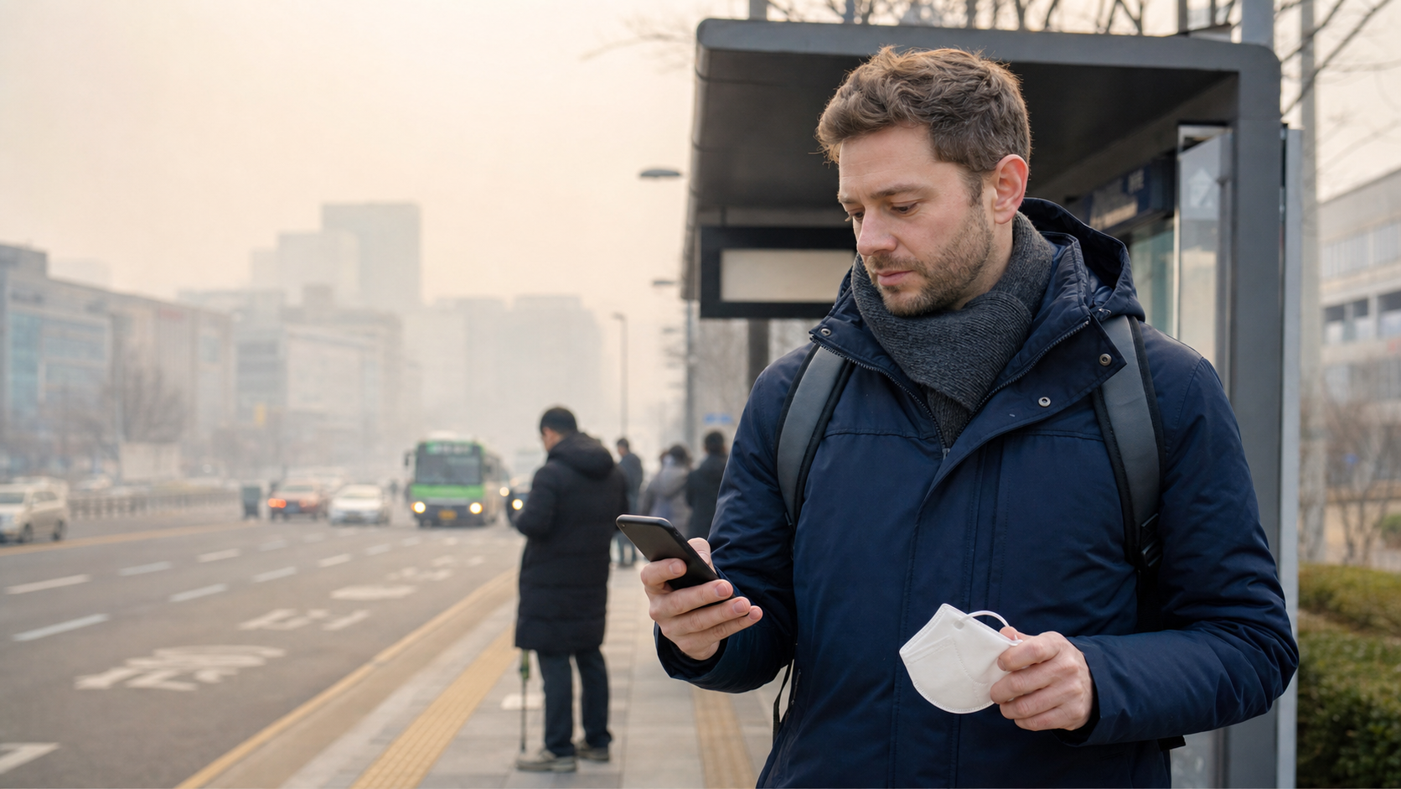
Reading Weather Formulas
현재 기온 = current air temperature
최고기온 / 최저기온 = high / low
강수량 = rainfall amount
Read the label first. Then read the number or level.
습도 = humidity
미세먼지 = fine dust
Notes:
This slide explains the formula style of weather screens. Many weather app lines are not full sentences. They are labels plus numbers, levels, or short warnings. 현재 기온 tells the current temperature. 최고기온 and 최저기온 show a daily range. 강수량 tells the amount of rain. 습도 explains sticky air, and 미세먼지 helps learners decide whether a mask or indoor plan is useful.

Slide 4
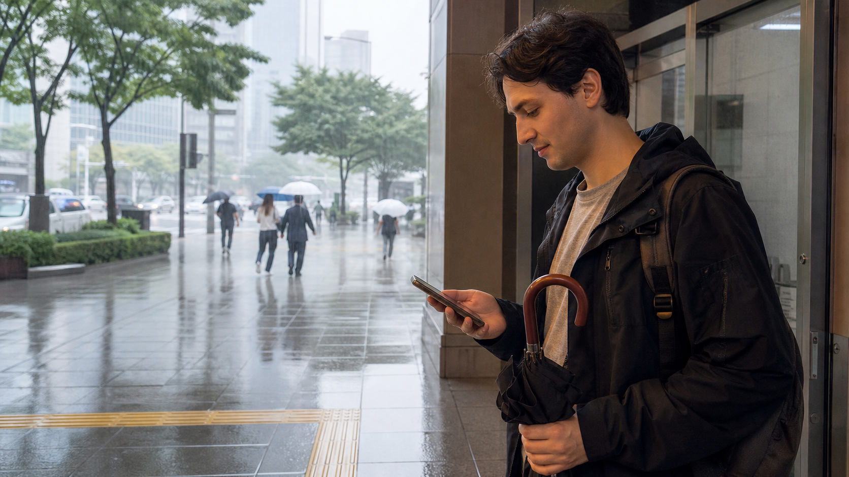
Read Forecasts in 3 Steps
1. Check 기온 and the high / low.
2. Look for 비, 소나기, or 강수량.
3. Check 미세먼지, then decide 우산.
Notes:
This slide turns vocabulary into an action sequence. First, learners check the temperature range so they can choose clothing. Next, they check rain words such as 비 and 소나기, then confirm 강수량 if the app gives more detail. Finally, they check 미세먼지 and decide whether to carry 우산 or change plans. The article will explain this as a simple screen-reading routine.

Slide 5

Mistakes and Practice
• Do not read 기온 as body temperature.
• Do not ignore 최저기온 at night.
• 소나기 can be short but sudden.
• 미세먼지 changes your outdoor plan.
Notes:
The final slide prepares the mistakes and practice sections. Beginners may confuse 기온 with body temperature or read only the current number while missing the high and low. They may also treat 소나기 like normal rain, but it can appear suddenly. 미세먼지 is not rain, but it still affects daily decisions. The article closes with recognition questions, a mini scenario, and a quick review table.

