Slide 1
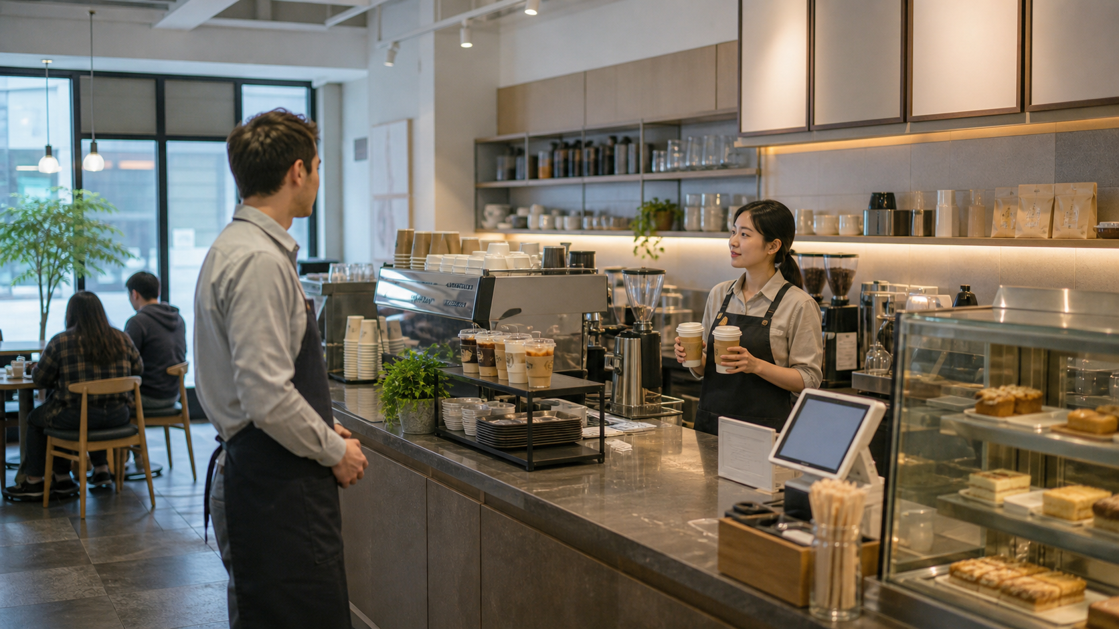
BSKorean
Korean Cafe Pickup and Order Number Phrases
Learn practical Korean for calling order numbers, handing drinks to customers, using vibration pagers, and explaining short waits at a Korean cafe.
주문번호 • 진동벨 • 픽업대

Slide 2
BSKorean
Lesson Goal
After this lesson, a foreign service worker should understand the main Korean words used between payment and pickup at a cafe counter.
This is Service Korean for real shifts.

Slide 3
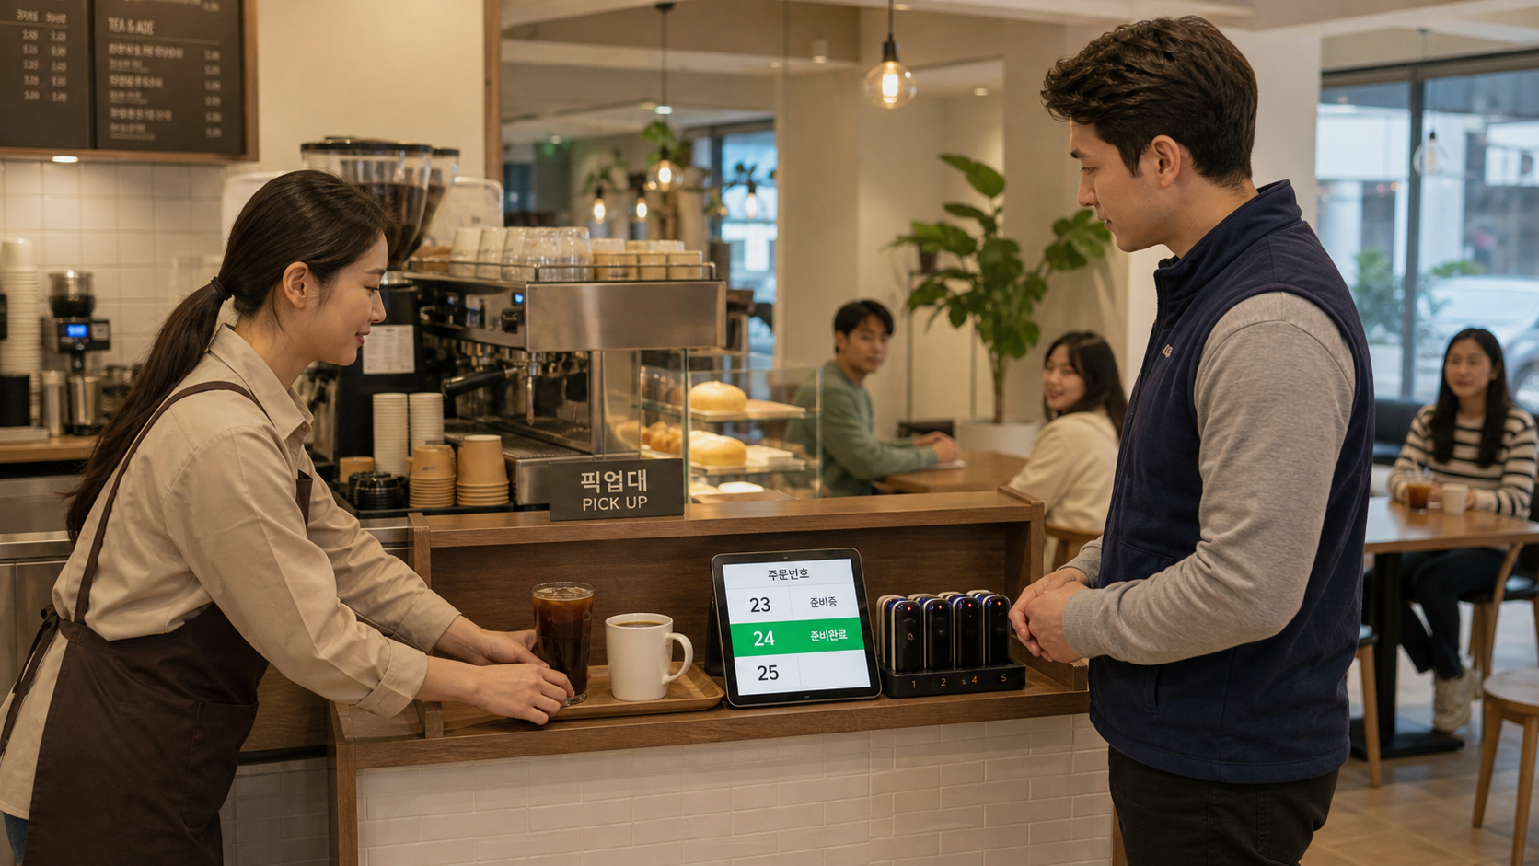
BSKorean
Opening Situation
A customer has paid. Drinks are not ready yet. You need to give a pager, check an order number, call the customer, and hand over the correct drink.
The key skill is fast confirmation.

Slide 4
BSKorean
Core Words
주문 order
주문번호 order number
번호 number
진동벨 vibrating pager
픽업대 pickup counter
음료 drink
준비 완료 ready
대기 waiting
Learn words as counter actions.

Slide 5
BSKorean
Pickup Flow
1. Give the pager.
2. Prepare the drink.
3. Check the order number.
4. Call or show the number.
5. Hand over the drink politely.
Do not hand over a drink before confirming.

Slide 6
BSKorean
Useful Patterns
N번 고객님
Customer number N
진동벨 울리면 와 주세요.
Please come when the pager rings.
음료 나왔습니다.
Your drink is ready.
Short patterns keep the line moving.

Slide 7
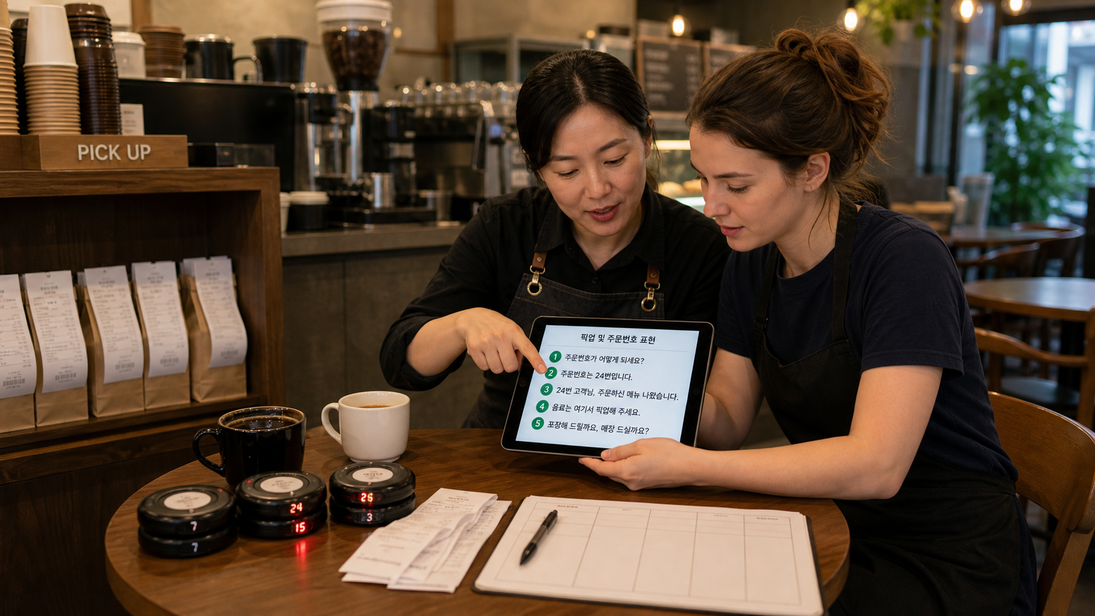
BSKorean
Mini Dialogue
Staff: 주문번호 확인해 주세요.
Customer: 24번이에요.
Staff: 네, 음료 나왔습니다.
Customer: 감사합니다.
Staff: 맛있게 드세요.
Simple confirmation prevents mistakes.

Slide 8
BSKorean
Common Mistakes
Mistake 1: Calling only a drink name.
Mistake 2: Confusing 매장 and 포장.
Mistake 3: Saying 가져가요 instead of 가져가세요.
Mistake 4: Ignoring order number checks.
Tone and confirmation both matter.

Slide 9
BSKorean
Review
Practice 주문번호, 번호, 진동벨, 픽업대, 음료, 준비 완료, 대기, 호출, 포장, 매장, 영수증, 확인, 손님, 카페, and 결제.
Practice this set in Word Practice and the BSKorean app.

