Slide 1
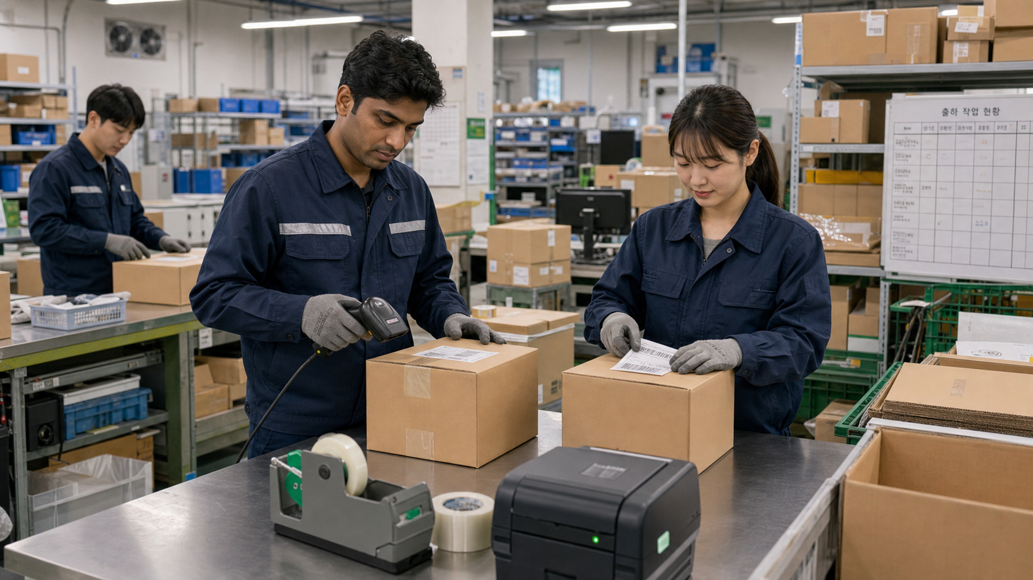
BSKorean
Korean Factory Packing and Labeling Phrases
Learn practical Korean for packing boxes, checking quantity, attaching labels, scanning barcodes, reporting defects, and preparing shipment.
포장 · 라벨 · 수량 · 출고

Slide 2
BSKorean
Opening Situation
You are at a Korean factory packing station. A supervisor says: 수량 확인하고 라벨 붙여 주세요. You need to know the task before the box moves to shipment.
Listen for task words first.

Slide 3
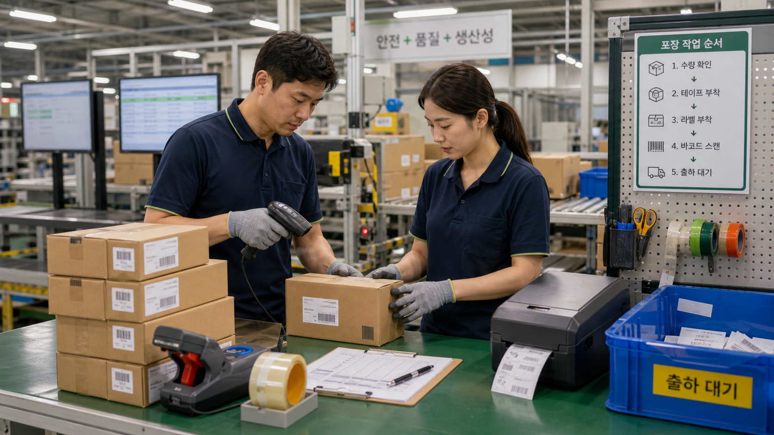
BSKorean
Why It Matters
Packing work uses short instructions. A worker must check products, count quantity, pack boxes, attach labels, scan barcodes, and report errors quickly.
Field Korean is practical workplace Korean.

Slide 4
BSKorean
Core Words
포장 packing
라벨 label
수량 quantity
박스 box
테이프 tape
검수 inspection
불량 defect
출고 shipment
Learn words as work task signals.

Slide 5
BSKorean
Work Phrases
수량 확인해 주세요.
Please check the quantity.
라벨 붙여 주세요.
Please attach the label.
바코드 스캔해 주세요.
Please scan the barcode.
Short polite phrases are enough.

Slide 6
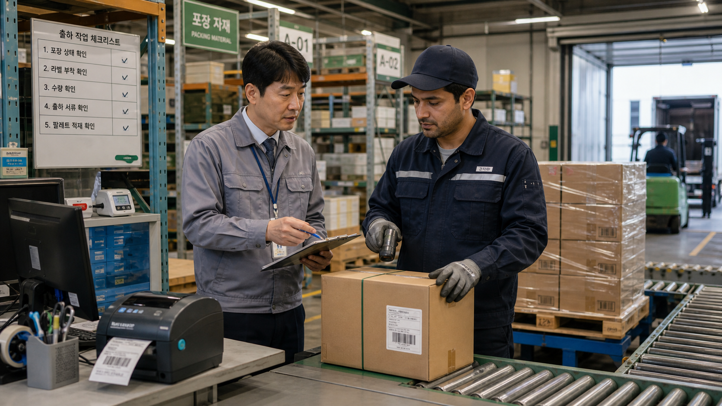
BSKorean
Mini Dialogue
Supervisor: 수량 확인했어요?
Worker: 네, 수량 맞습니다.
Supervisor: 라벨도 붙였어요?
Worker: 네, 라벨 붙이고 출고 준비했습니다.
Confirm quantity before shipment.

Slide 7
BSKorean
Common Mistakes
Mistake 1: Confusing 수량 and 중량.
Mistake 2: Shipping before label check.
Mistake 3: Treating 불량 as a small note.
Small packing errors can stop shipment.

Slide 8
BSKorean
Practice Steps
1. Check the product.
2. Count the quantity.
3. Pack the box.
4. Attach the label.
5. Report defects or errors.
Use the same routine for every box.

Slide 9
BSKorean
Review
Practice 포장, 라벨, 수량, 중량, 박스, 테이프, 검수, 불량, 누락, 출고, 송장, 바코드, 스캔, 파레트, 적재, and 관리자.
Practice this set in Word Practice.

