Slide 1
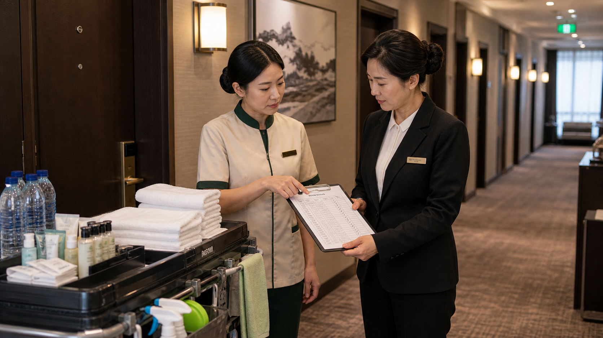
BSKorean
Korean Hotel Cleaning Room Status Phrases
Learn practical Korean for hotel housekeeping: room status, cleaning completion, amenities, inspection, lost items, and supervisor reports.
객실 · 청소 완료 · 비품 · 점검

Slide 2
BSKorean
Opening Situation
You arrive at a hotel housekeeping station. A supervisor says: “이 객실은 아직 청소 전이에요.” You need to know the room status before you enter.
Read room status before starting work.

Slide 3
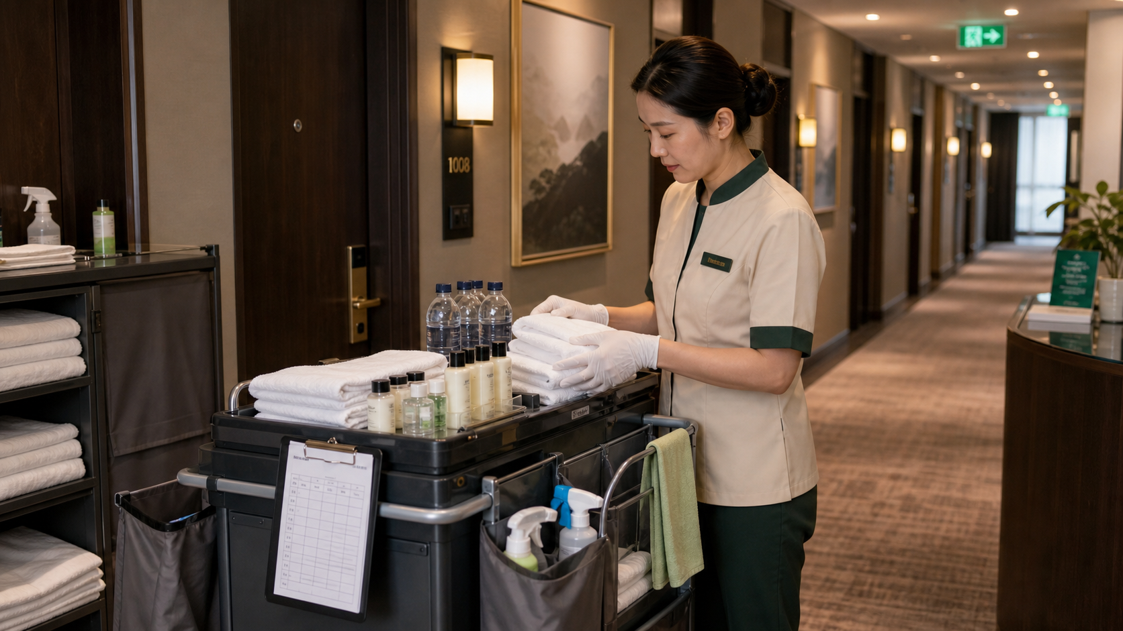
BSKorean
Why It Matters
Hotel cleaning Korean is about timing and reporting. A room can be checked out, occupied, cleaning in progress, completed, inspected, or delayed.
Service Korean + workplace reporting.

Slide 4
BSKorean
Core Words
객실 room
청소 cleaning
청소 전 before cleaning
청소 중 cleaning in progress
청소 완료 cleaning done
비품 amenities
수건 towels
보충 restock
Learn words as work status signals.

Slide 5
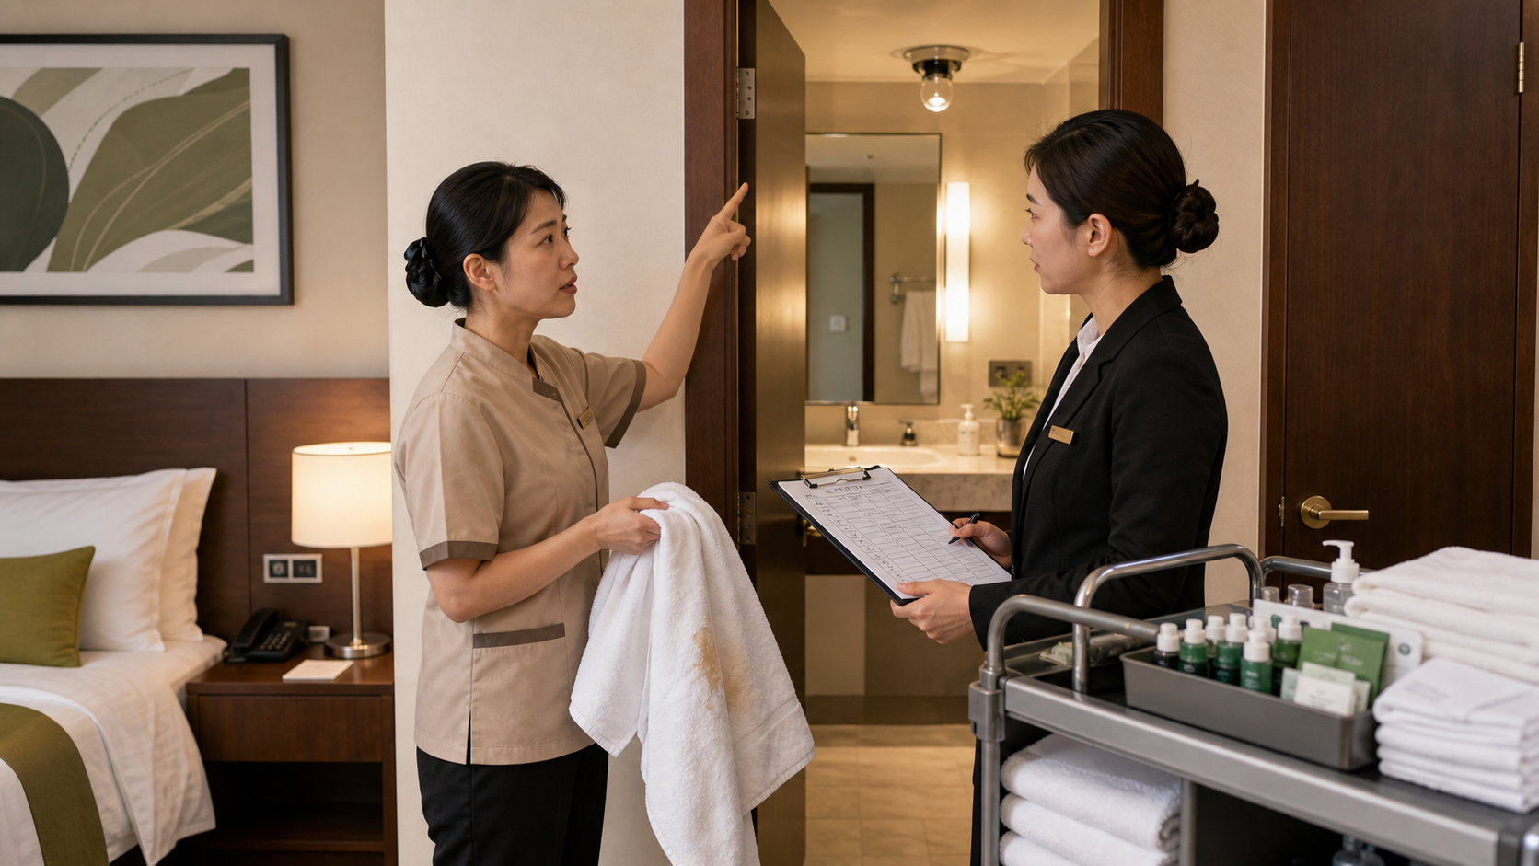
BSKorean
Report Phrases
청소 완료했습니다.
I finished cleaning.
비품 보충했습니다.
I restocked the amenities.
점검 부탁드립니다.
Please inspect it.
Short polite phrases are enough.

Slide 6
BSKorean
Mini Dialogue
Supervisor: 1205호 청소 끝났어요?
Worker: 네, 청소 완료했습니다.
Supervisor: 비품은 보충했어요?
Worker: 네, 수건하고 생수 보충했습니다.
Listen for room number + task word.

Slide 7
BSKorean
Common Mistakes
Mistake 1: Confusing 청소 전 and 청소 완료.
Mistake 2: Saying 청소 끝 instead of polite 청소 완료했습니다.
Mistake 3: Ignoring 분실물 reports.
Some mistakes affect room readiness.

Slide 8
BSKorean
Practice Steps
1. Check the room number.
2. Listen for the status word.
3. Confirm supplies.
4. Report problems clearly.
Example: 1205호 청소 완료했습니다.
Use the same routine each room.

Slide 9
BSKorean
Review
Practice 객실, 청소 전, 청소 중, 청소 완료, 비품, 수건, 생수, 보충, 점검, 분실물, 오염, 고장, 보고, 관리자, and 확인.
Practice this set in Word Practice.

