Slide 1
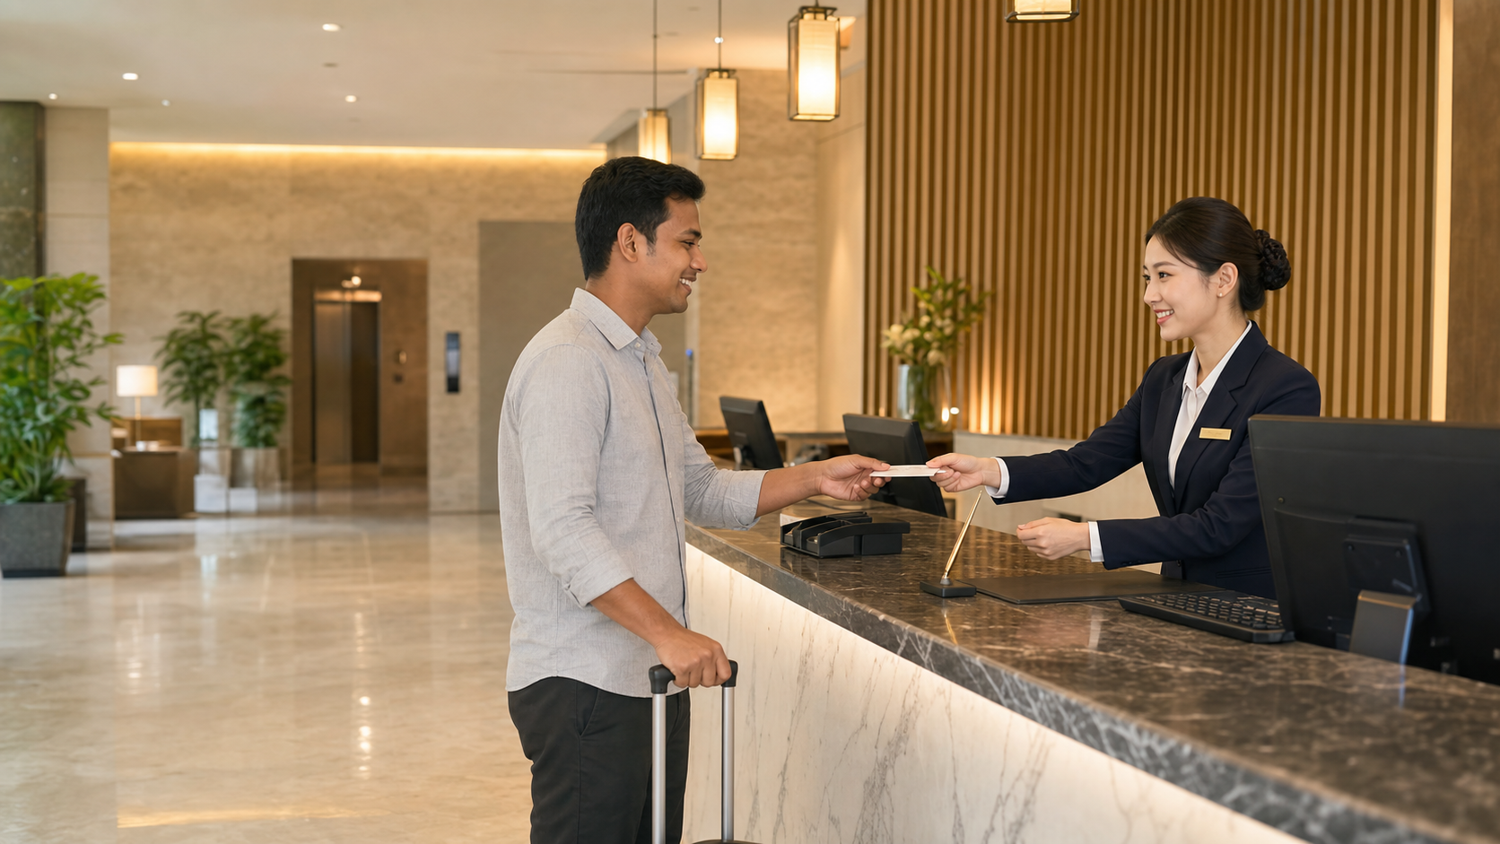
BSKorean
Korean Hotel Front Desk Check-in Phrases
Learn practical Korean for hotel front desk work: reservation check, guest name, passport or ID, room key, breakfast, deposit, payment, and check-out time.
예약 확인 · 신분증 · 객실 키

Slide 2
BSKorean
Opening Situation
A guest arrives at the front desk. You need to confirm the reservation, ask for ID, explain the room, mention breakfast, and answer one simple request.
The goal is clear, polite check-in flow.

Slide 3
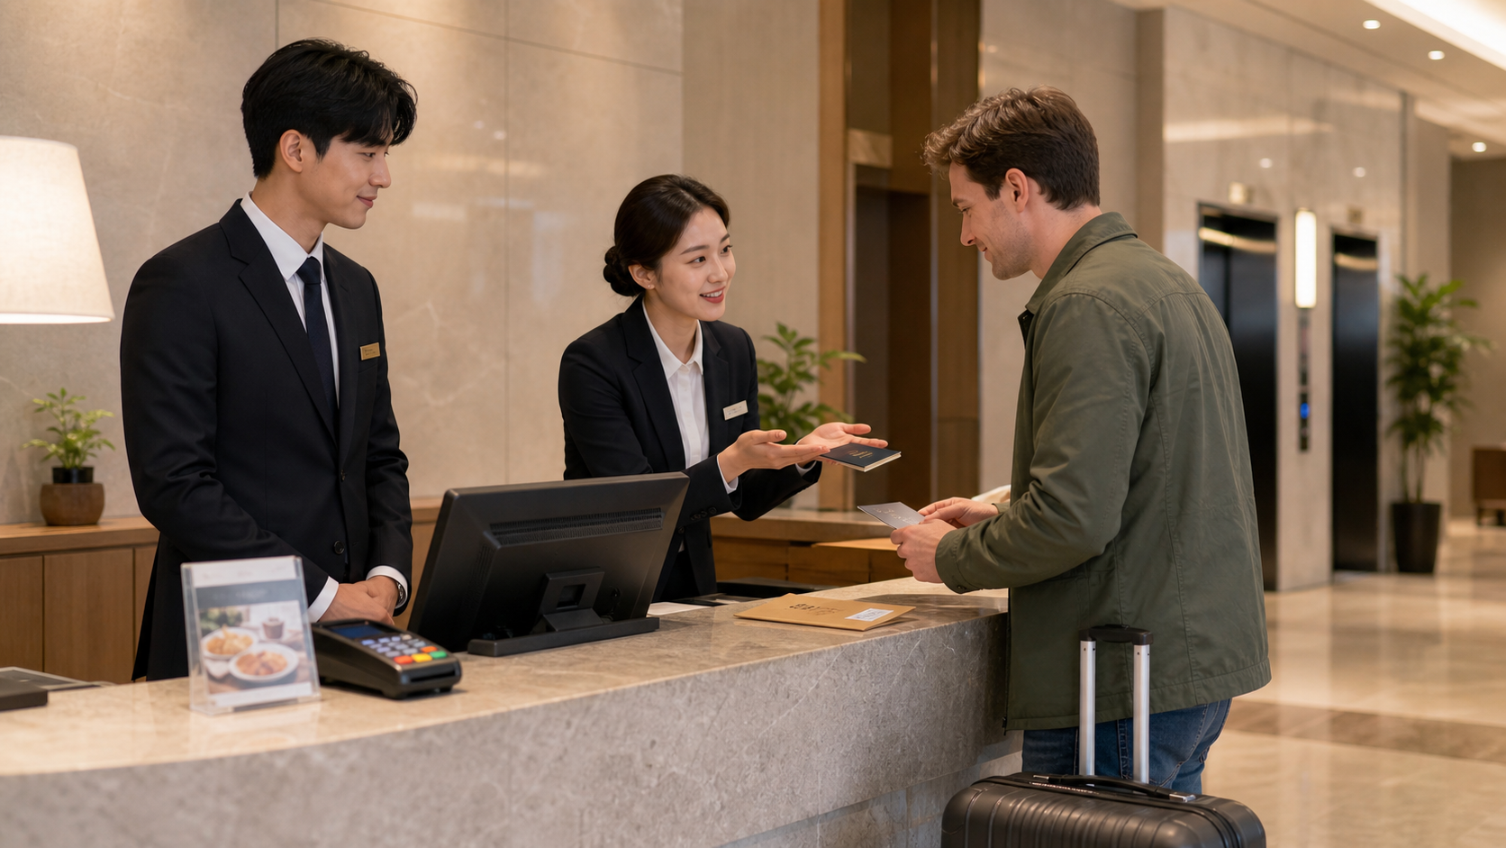
BSKorean
Why It Matters
Hotel check-in Korean is service Korean plus workplace Korean. A small mistake can delay the guest, confuse payment, or send someone to the wrong floor.
Short phrases protect service quality.

Slide 4
BSKorean
Core Words
예약 reservation
성함 name (polite)
신분증 ID
여권 passport
객실 room
객실 키 room key
조식 breakfast
보증금 deposit
Learn each word as a front desk action.

Slide 5
BSKorean
Check-in Flow
1. Confirm the reservation.
2. Ask for ID or passport.
3. Explain the room and key.
4. Explain breakfast and check-out.
5. Invite questions politely.
One step, one short phrase.

Slide 6
BSKorean
Useful Patterns
N 확인 도와드리겠습니다
I will help check N.
N 보여 주시겠어요?
Could you show me N?
N은/는 ___입니다
N is ___.
Patterns keep service language calm.

Slide 7
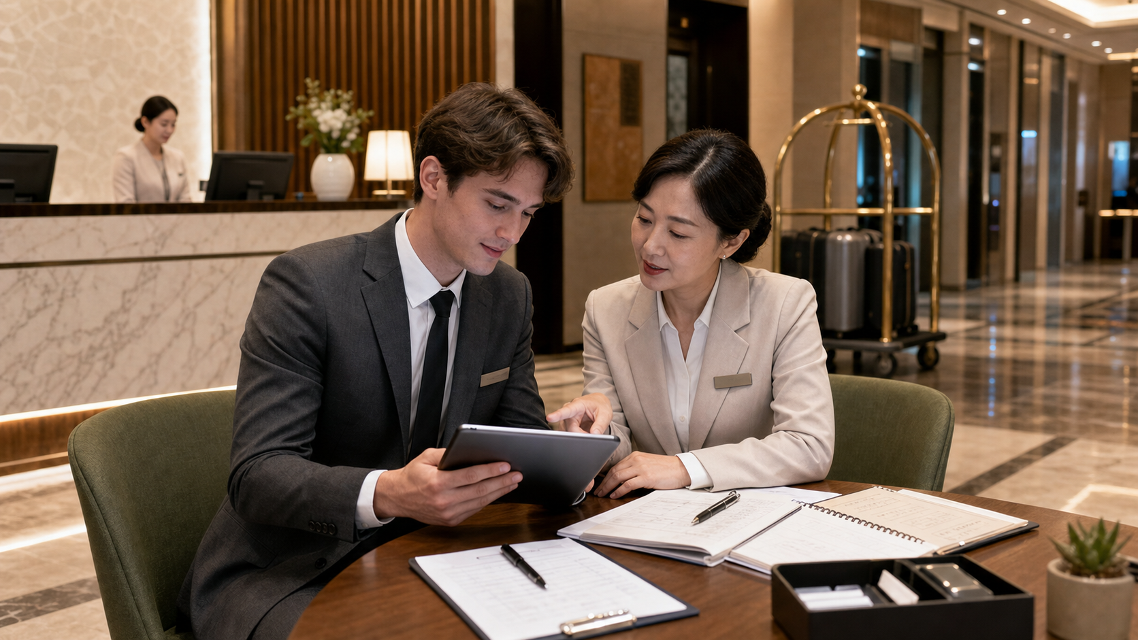
BSKorean
Mini Dialogue
Staff: 예약 확인 도와드리겠습니다.
Guest: 네, 김민수로 예약했어요.
Staff: 신분증 확인 부탁드립니다.
Guest: 여기 있습니다.
Staff: 객실은 1205호입니다.
Confirm before giving the room key.

Slide 8
BSKorean
Common Mistakes
Mistake 1: Using 이름 instead of 성함.
Mistake 2: Saying 신분증 주세요 too directly.
Mistake 3: Explaining breakfast, deposit, and check-out in one long sentence.
Polite and short is better.

Slide 9
BSKorean
Review
Practice 예약, 예약 확인, 성함, 신분증, 여권, 객실, 객실 키, 체크인, 체크아웃, 조식, 보증금, 결제, 서명, 안내, 엘리베이터, 층, 와이파이, 금연, 요청, and 문의.
Practice this set in Word Practice.

