Slide 1
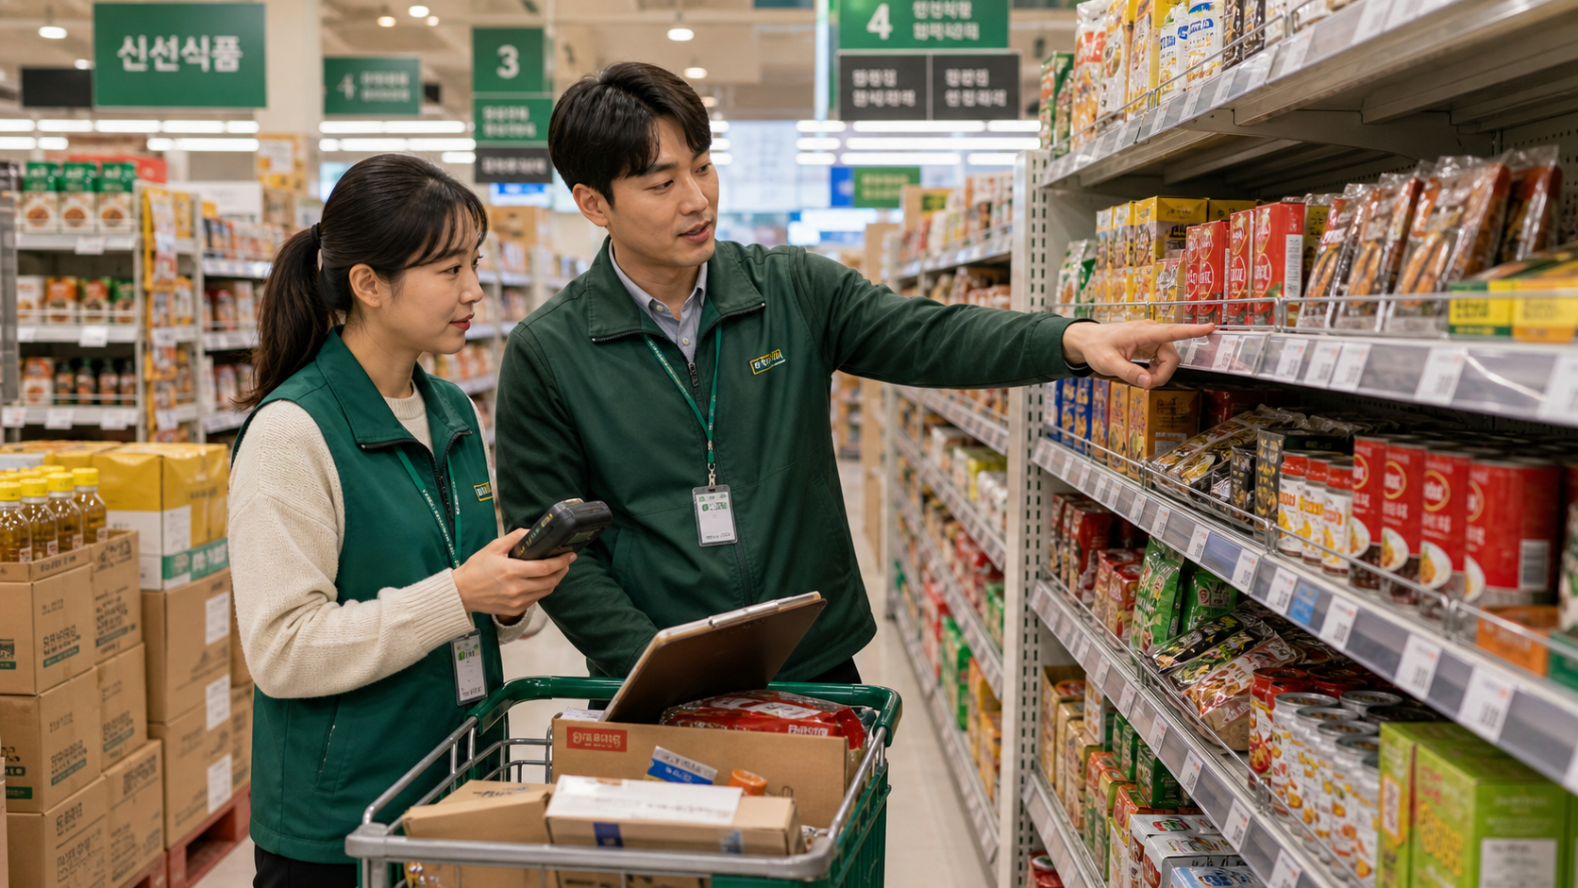
BSKorean
Korean Retail Stocking and Price Tag Phrases
Learn practical Korean for shelf stocking, price tags, inventory, discounts, sold-out items, barcode scans, and customer questions.
진열 · 가격표 · 재고 · 품절

Slide 2
BSKorean
Opening Situation
You are working in a Korean mart. A supervisor says: “이 상품 가격표 확인하고 진열대 보충해 주세요.” You need to understand the task quickly.
Listen for the task word first.

Slide 3
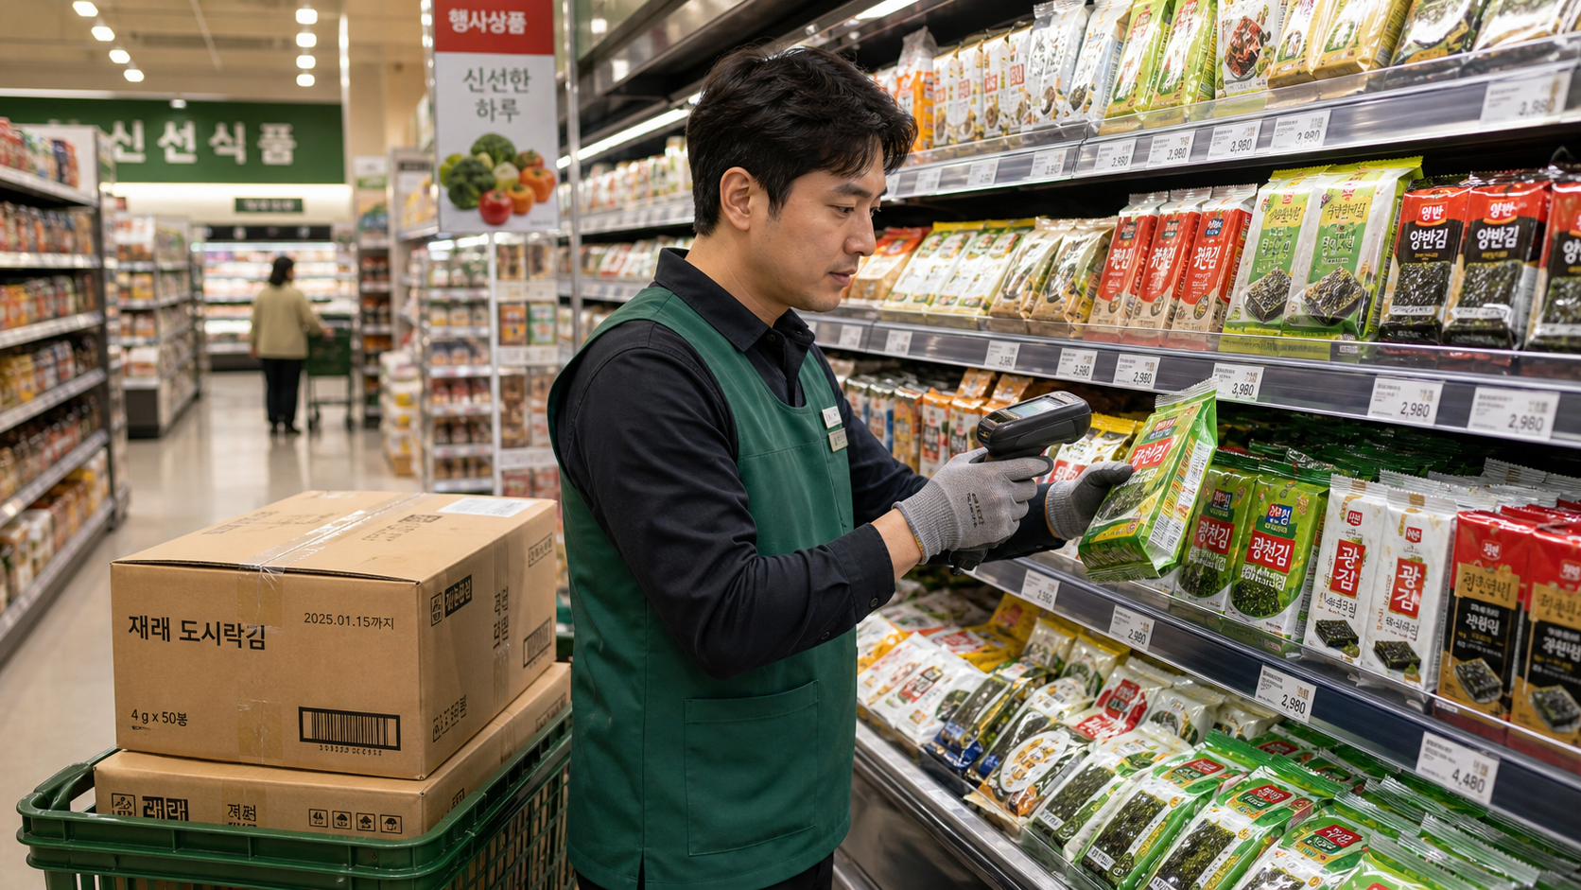
BSKorean
Why It Matters
Retail work uses short instructions. A worker may need to display products, check price tags, restock shelves, report out-of-stock items, or answer customer questions.
Service Korean is workplace Korean.

Slide 4
BSKorean
Core Words
매장 store
진열 display
진열대 shelf
상품 product
재고 stock
품절 sold out
가격표 price tag
할인 discount
Learn words as store task signals.

Slide 5
BSKorean
Work Phrases
가격표 확인해 주세요.
Please check the price tag.
진열대 보충해 주세요.
Please restock the shelf.
이 상품 품절입니다.
This item is sold out.
Short polite phrases are enough.

Slide 6
BSKorean
Mini Dialogue
Manager: 이 상품 재고 있어요?
Worker: 네, 창고에 있습니다.
Manager: 그럼 진열대 보충해 주세요.
Worker: 네, 가격표도 확인하겠습니다.
Room for both stock and price tasks.

Slide 7
BSKorean
Common Mistakes
Mistake 1: Thinking 재고 means display shelf.
Mistake 2: Ignoring 가격표 after restocking.
Mistake 3: Confusing 할인 and 행사.
Small label mistakes affect customers.

Slide 8
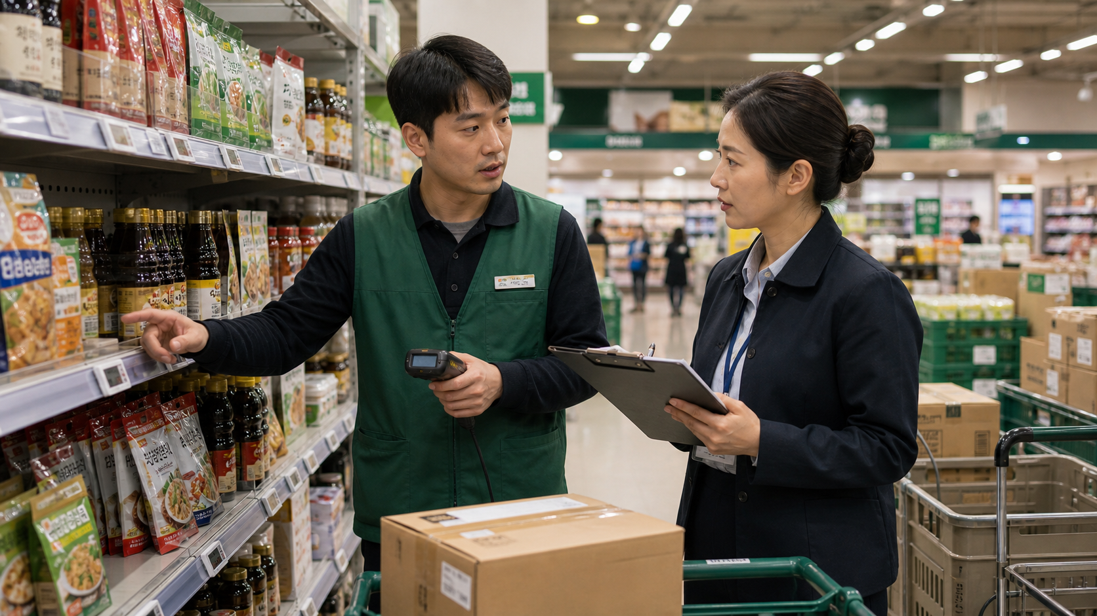
BSKorean
Practice Steps
1. Find the product.
2. Check stock.
3. Restock the shelf.
4. Check the price tag.
5. Report errors clearly.
Use the same routine every aisle.

Slide 9
BSKorean
Review
Practice 매장, 진열, 진열대, 상품, 재고, 품절, 가격표, 할인, 행사, 유통기한, 보충, 바코드, 스캔, 오류, and 관리자.
Practice this set in Word Practice.

