Slide 1
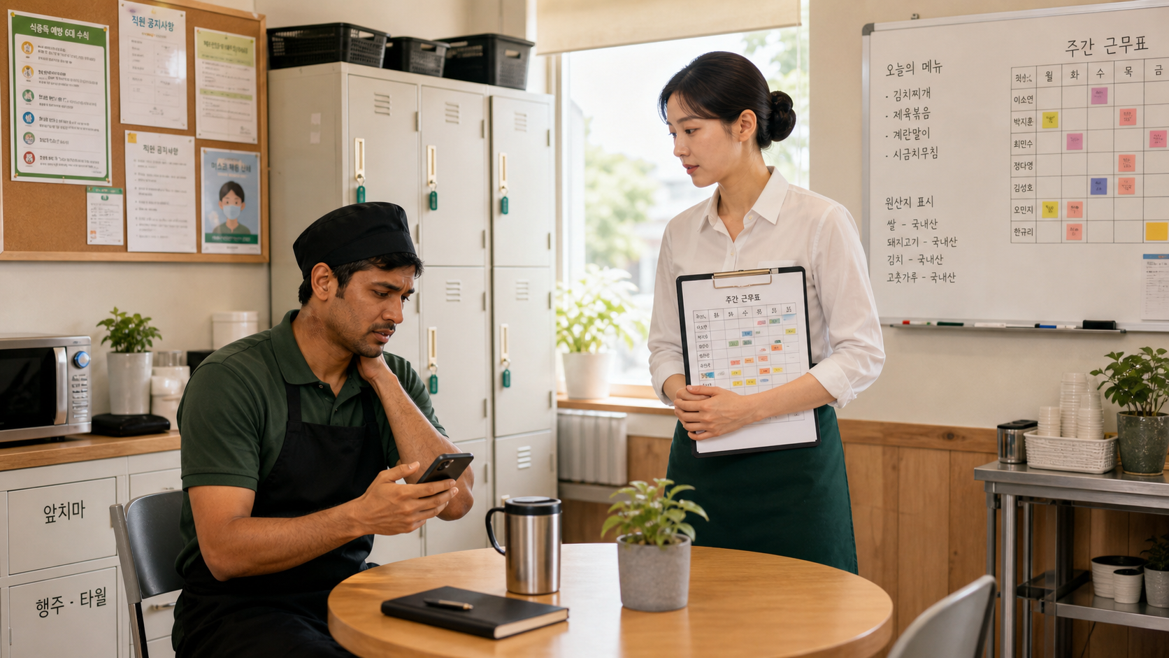
BSKorean
Korean Workplace Sick Leave and Absence Phrases
Learn practical Korean for reporting sickness, lateness, absence, early leave, schedule changes, and manager confirmation at work.
결근 · 지각 · 병가 · 조퇴

Slide 2
BSKorean
Opening Situation
You wake up sick before work. Your shift starts soon. You need to contact your manager and say: 몸이 안 좋아서 오늘 출근이 어렵습니다.
Report early and politely.

Slide 3
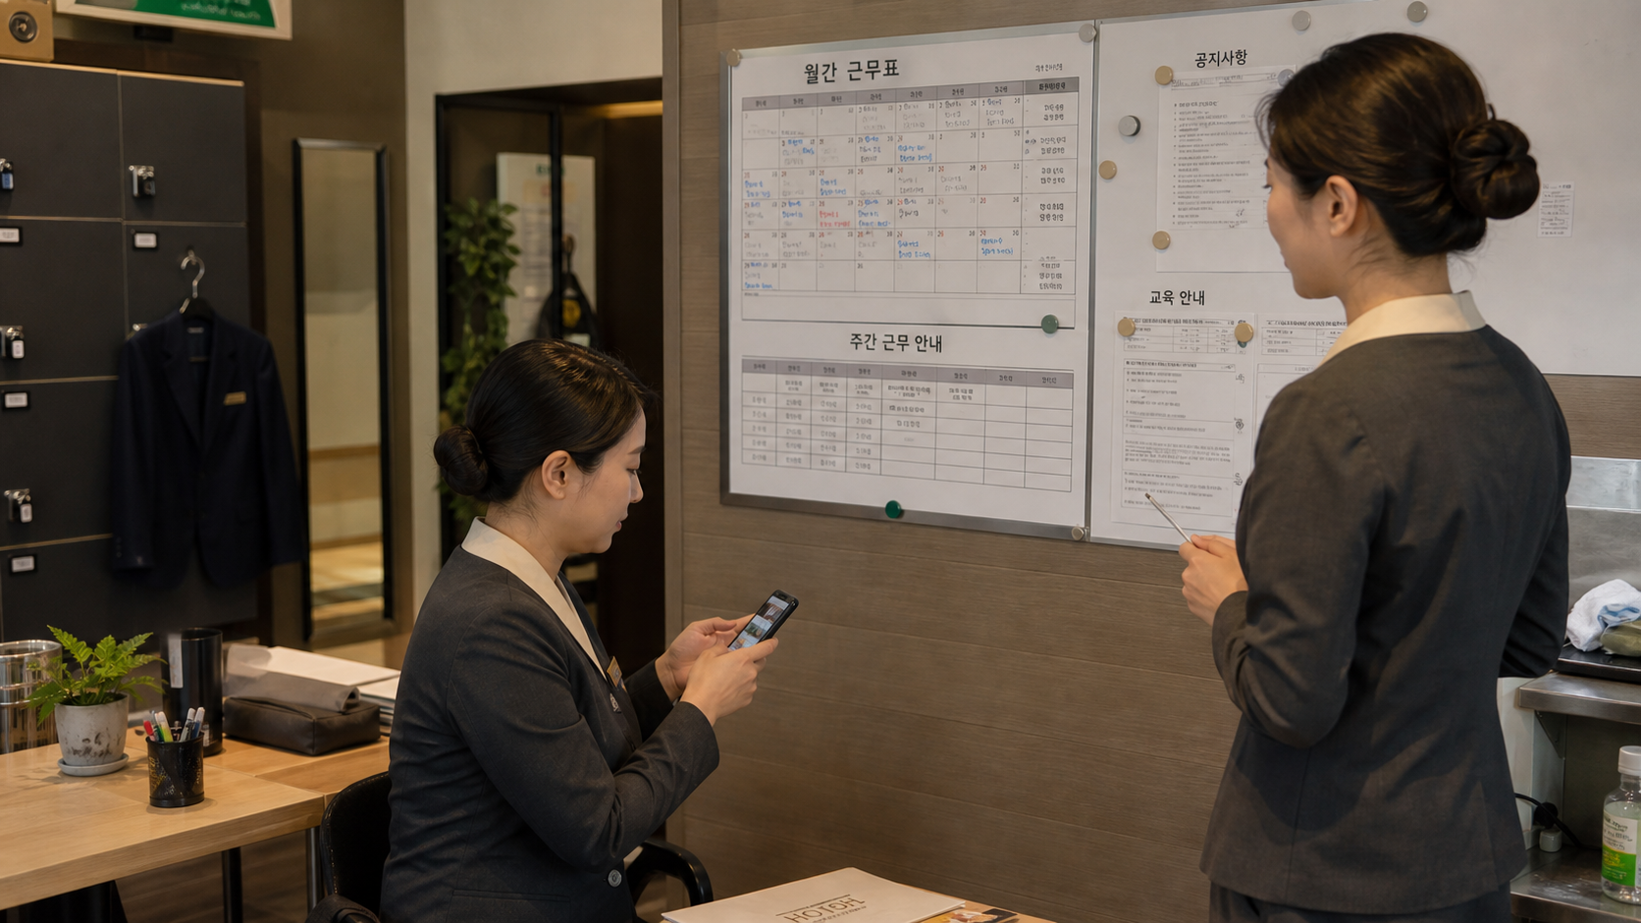
BSKorean
Why It Matters
In Korea, absence and lateness should be reported clearly. A short message can help the manager adjust the schedule, find replacement staff, and avoid confusion.
Workplace Korean protects the shift.

Slide 4
BSKorean
Core Words
결근 absence
지각 lateness
조퇴 leave early
병가 sick leave
연차 annual leave
휴가 leave
근무표 schedule
교대 shift change
Learn words as reporting signals.

Slide 5
BSKorean
Report Phrases
몸이 안 좋습니다.
I do not feel well.
오늘 출근이 어렵습니다.
I cannot come to work today.
조퇴해도 될까요?
May I leave early?
Use polite and direct phrases.

Slide 6
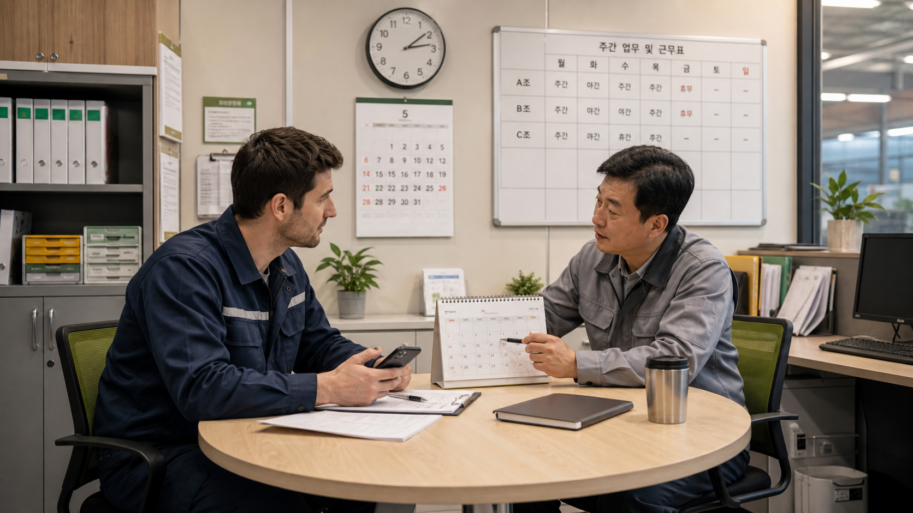
BSKorean
Mini Dialogue
Worker: 몸이 안 좋아서 오늘 출근이 어렵습니다.
Manager: 병원에 가야 하나요?
Worker: 네, 진료 받고 연락드리겠습니다.
Manager: 알겠습니다. 근무표 확인하겠습니다.
Reason + action + follow-up.

Slide 7
BSKorean
Common Mistakes
Mistake 1: Saying only 아파요.
Mistake 2: Reporting too late.
Mistake 3: Confusing 병가 and 연차.
Give the manager enough information.

Slide 8
BSKorean
Practice Steps
1. Say the reason.
2. Say today’s work problem.
3. Ask or report clearly.
4. Mention hospital or follow-up.
5. Confirm the manager’s answer.
Short, clear, polite.

Slide 9
BSKorean
Review
Practice 결근, 지각, 조퇴, 병가, 연차, 휴가, 몸살, 감기, 열, 병원, 진료, 연락, 보고, 근무표, 교대, 대체 근무, and 관리자.
Practice this set in Word Practice.

